Slide 1

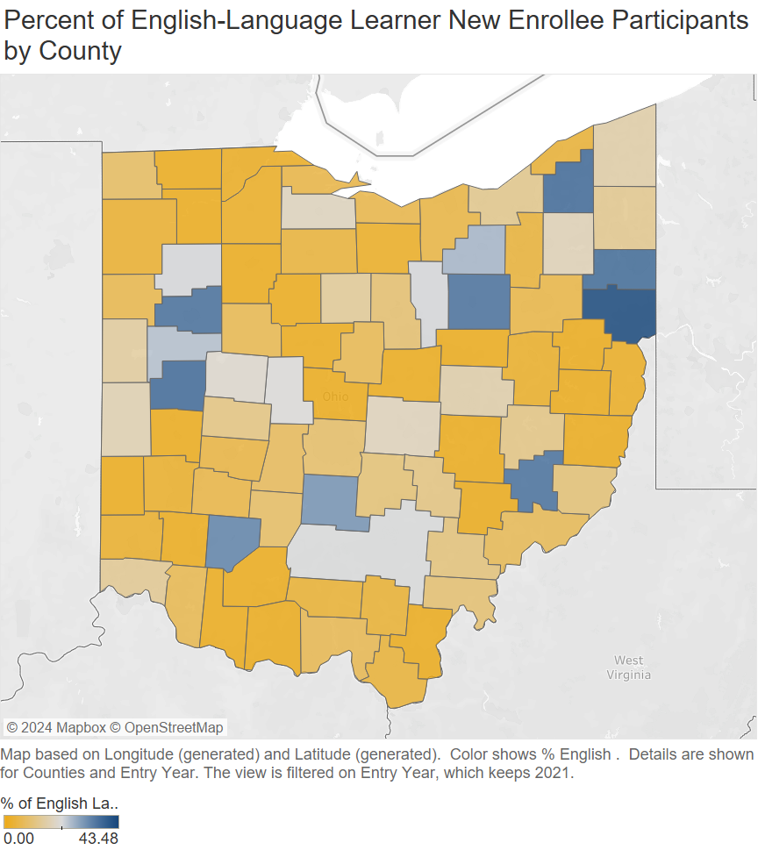
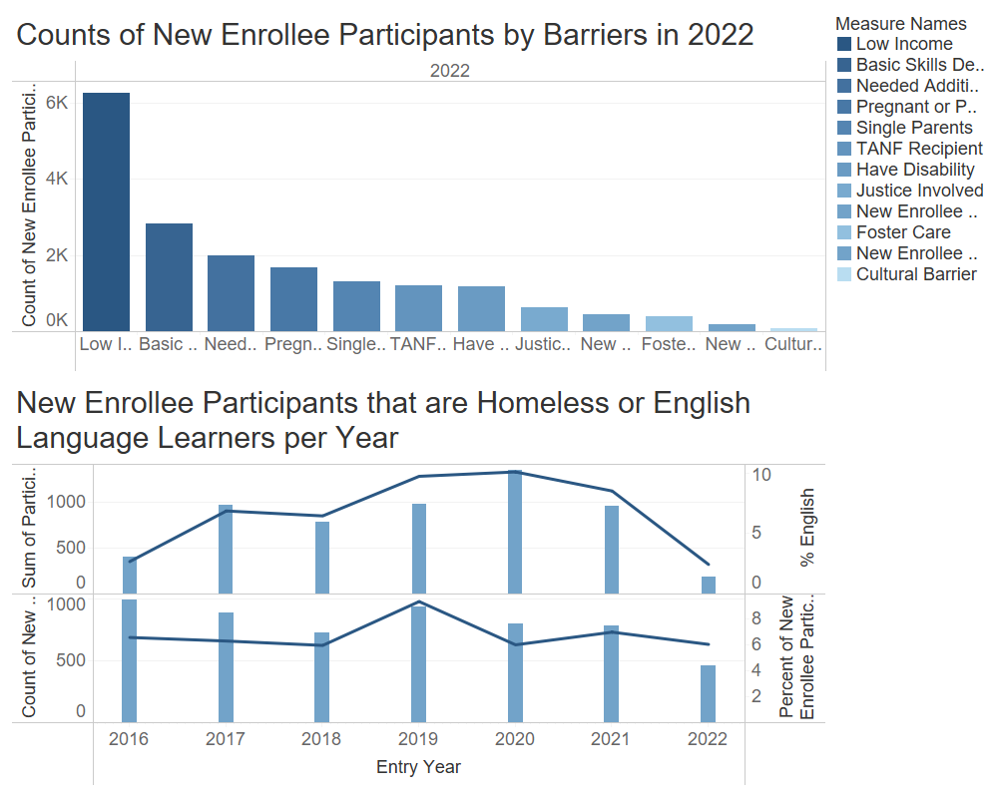
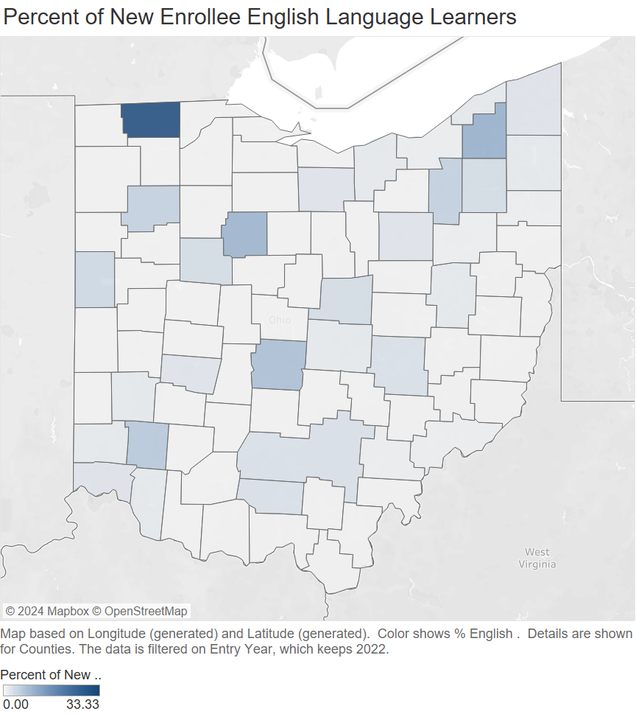
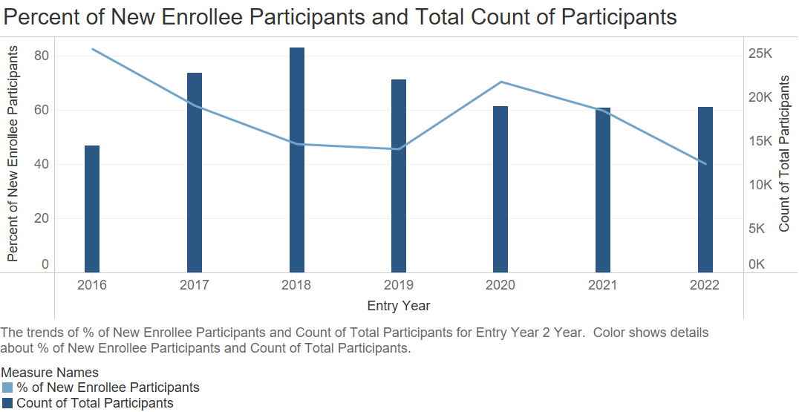
Comprehensive Case Management & Employment Program
Ohio Education and Research Center, Ohio Department of Jobs and Family Services
Isabelle Frohlich
How do ELLs Present Across the State in 2020?
New ELLs Across the State in 2022
What is CCMEP?
What Does This Show?
Statewide New Enrollee ELLs in 2022
      The Comprehensive Case Management and Employment Program (CCMEP) employment and workforce development program within the Ohio Department of Jobs and Family Services. It offers services for low-income young Adults ages 14 to 24 to help them prepare for and enter careers. The program provides services ranging from career coaching to job placement, financial incentives and tuition assistance.
  The total number of participants decreased after 2018
  The total number of participants is slowly increasing once again, beginning in 2020
  The program is still recovering from the Covid-19 Pandemic
  The percentage of new enrollee participants also took a hit with the pandemic, but is recovering
  In 2022, there were only 185 new enrollee participants that were ELLs. The county with the highest percentage of new enrollee participants that were ELLs was Fulton county, at 33.3% or 4 participants. While this is a small number of participants, comparatively there were only a total 12 new enrollee participants in Fulton County. In the state of Ohio there was a small number of new enrollee ELL participants compared to previous years.
Examining Specific Populations of New Enrollees
CCMEP Data
Participants generally must be low-income and have a barrier to employment to join the program. The counts of all the barriers are recorded below. One of the barriers that participants face is being an ELL and/or being homeless.
Conclusion
ICF Data Compared to Program Year 2022
  The CCMEP program is working towards increasing enrollment which declined during COVID-19. ELLs are a subpopulation of a larger program. With less new enrollee participants, CCMEP is expected to serve fewer members of this subpopulation.
  In the end, it is up to the counties to recruit new enrollees and if they choose to focus on a specific group of participants.
  ICF, created a data set from pre-2016 through PY 2021
  I transformed all variables from PY 2022 to match the variables created by ICF, an outside evaluator, from previous years’ data
  Transformations and data cleaning took place in Excel
  After the data sets were combined, I visualized and examined through Tableau
  I specifically looked at new enrollee participants, based on participant program entry year, rather than total participants
  I examined entry barriers, demographics, and other key variables for participants
  I created 93 worksheets, 24 dashboards, and 3 stories
New Enrollee ELLs Across the State in 2020
Statewide New Enrollee ELLs in 2020
  In 2020 there were 1,349 new enrollees ELLs spread out across the state. The county in 2020 with the most new enrollee ELL participants was Coshocton County with 47.92% or 23 of new enrollee participants being ELLs. The volume is based on the percentage of ELL new enrollees compared to total new enrollees per county.
  2020 was the year with the most ELL new enrollee participants.
Bibliography
      Unemployed Workers. JFS - Ohio Unemployment Compensation - Unemployed Workers. (n.d.). https://unemployment.cmt.ohio.gov/cmtview/loginc.jsp
      Ohio Department of Job and Family Services. (n.d.-b). https://jfs.ohio.gov/owd/CCMEP/docs/CCMEPARIESGuide.pdf
      Batalova, J. B. J. (2024, April 4). Frequently requested statistics on immigrants and immigration in the United States. migrationpolicy.org. https://www.migrationpolicy.org/article/frequently-requested-statistics-immigrants-and-immigration-united-states-2024#:~:text=Between%202021%20and%202022%2C%20the,out%20of%20nearly%201.4%20million).
      Camarota, S. A., & Zeigler, K. (2017). US immigrant population hit record 43.7 million in 2016.
What are the Trends of New Enrollee Participants Versus Total Participants?
How do ELLs Present Across the State in 2022?
How Do ELL’s and Homeless Participants Compare?
Acknowledgements
New Enrollee ELLs
      I would like to thank Theresa Groth-Joynt and Gerrie Cotter for allowing me to work on such a great project and being supportive mentors! A special thank you to Joshua Hawley, Ceanna Burnheimer, and Xiangyu Ren for providing guidance and advising me on this project! Thanks to my fellow interns, Sam and Ella!
  Though there has been a steady incline in the number of ELLs served through CCMEP, the number of those served during 2021 and 2022 drastically declined.
  For example, in 2020, the percent of ELL new enrollee participants served was 10.1%, compared to 2.4% in 2022.
  While the number of new enrollee participants that are homeless has also declined, it has not been as drastic. The percentage of new enrollee homeless participants is not too far off from the highest percentage, 9.3% in 2019, compared to 6% in 2020.
Notes
      All data has been provided by ODJFS. The data from pre-2016 through 2022 was provided by ICF through ODJFS and ODJFS provided raw data from 2022.

