Slide 1


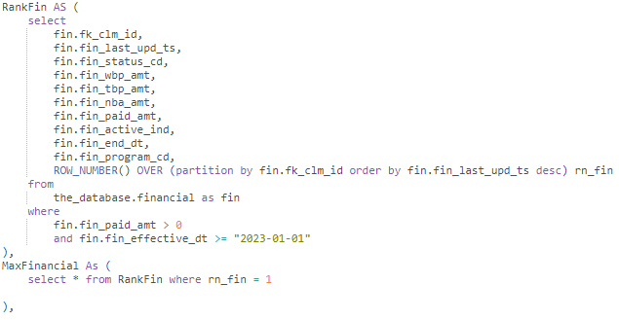
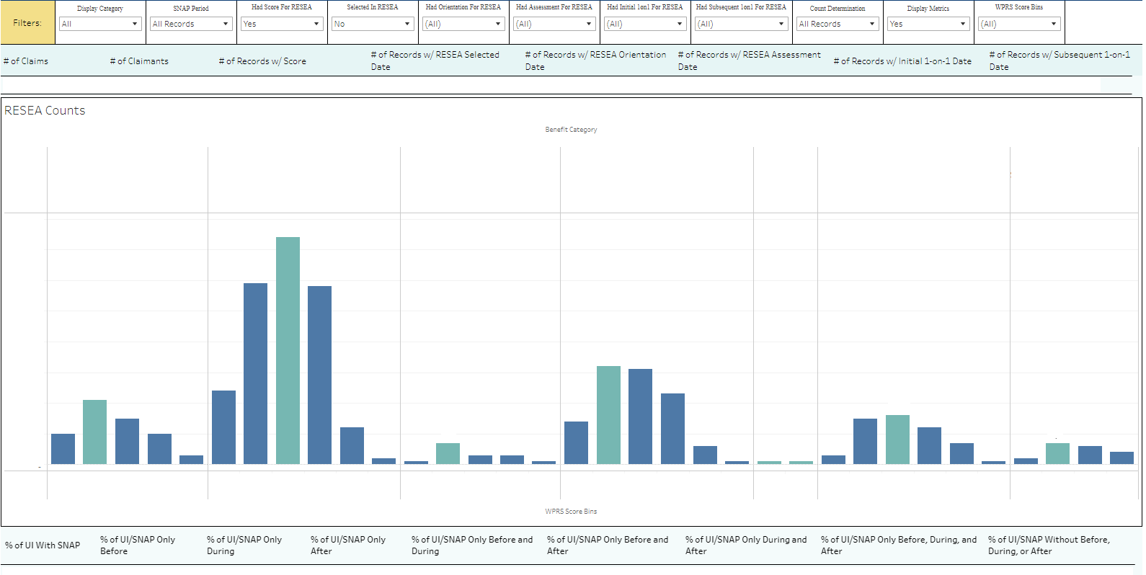
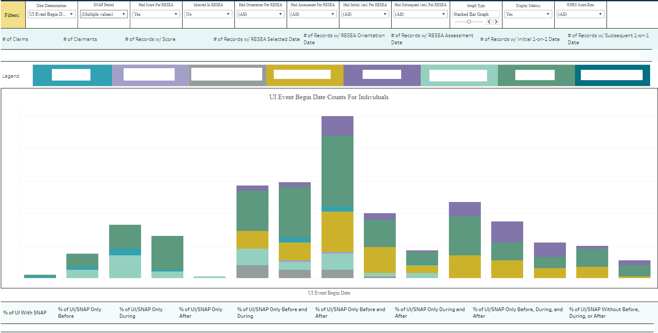
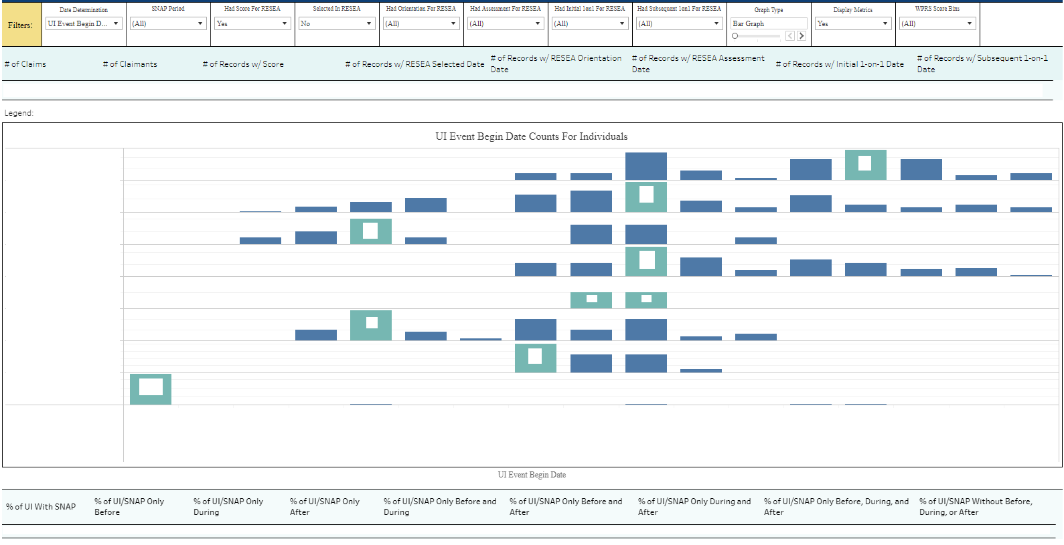
RESEA Participant Analysis
Ohio Department of Job and Family Services
Ohio Education Research Center
Samuel Gadkar
Background Information
SQL Code
Tableau Visualizations
What We Noticed
      The Re-employment Services and Eligibility Assessment (RESEA) is a mandatory program that aims to help individuals who are most likely to exhaust their unemployment benefits (UI). UI is a monetary benefit eligible workers can receive after losing their job. The target group for this project are individuals who are in UI and some other state program, such as the Supplemental Nutrition Assistance Program (SNAP).
  Filters and Parameters
  Counts and Percentages
  Legend
  Graph/Table
  Dashboard actions for the drill-through
  Who the RESEA program is covering and their scores
  Who can potentially be included in the RESEA program
  What categories individuals in RESEA fall into when it comes to UI and SNAP
Filters
RESEA Program Steps
Counts
Legend
  Those chosen to be assessed in RESEA will be scored on a scale of 0 to 100
  A higher score means they are more likely to exhaust the benefits they currently receive
  Based on their score, individuals will be selected in RESEA and work through the program
  The program may include an initial and subsequent one-on-one where individuals are provided guidance and information on their next steps to become reemployed
What Was The Data
Graph
      RESEA
      Name and SSN
      RESEA Score
      Dates (selected, orientation, assessment, 1-on-1)
      UI
      Claim and Claimant identifier
      Claim Effective Date and Benefit Year End Date
      Max Warrant Date
      Program Code
      Address
      SNAP
      SSN
      SNAP Payment Dates
      Joining RESEA, UI, and SNAP
      UI and SNAP by SSN
      UI/SNAP and RESEA by claim identifier
Percentages
Visualization above does not represent the real data about individuals in UI, SNAP, and RESEA
Visualization above does not represent the real data about individuals in UI, SNAP, and RESEA
Research Question
How This Helps
  How is the RESEA model scoring individuals on UI and SNAP?
  How is this population utilizing the RESEA program?
      ODJFS has a better understanding of the RESEA model
      Customers who are on multiple benefits could be prioritized in the RESEA program
Software Utilized
Future Steps
  SQL on Impala
  Extracted data from multiple sources
  Joined the data to a single table
  Tableau
  Interactive dashboard to visualize the data
      Gather data on TANF and CS
      Analyze individuals in TANF and UI or CS and UI
      Identify additional individuals that can join or be reprioritized in the RESEA program
Visualization above does not represent the real data about individuals in UI, SNAP, and RESEA
Program Abbreviations
Valuable Metrics
Important Aspects of Visualizations
  RESEA - Re-employment Services and Eligibility Assessment
  UI - Unemployment Benefits
  SNAP - Supplemental Nutrition Assistance Program
  TANF - Temporary Assistance for Needy Families
  CS - Child Support
How SQL Was Used
  # of claims/claimants
  # of records with score/selected date/orientation date/ assessment date
  # of records with initial /subsequent 1-on-1 date
  % of UI with SNAP
  % of UI/SNAP Only Before/During/After
  % of UI/SNAP Only Before and During/Before and After/During and After
  % of UI/SNAP Only Before, During, and After
  % of UI/SNAP Without Before, During, or After
  % of UI/SNAP Continuous
  Parameters in Tableau
  Numerous filters available to user:
        Display Category
        RESEA Program Steps
        RESEA Score Bins
      Drill-through to a separate table dashboard
      RESEA counts and record counts
      Dynamically changing metrics based on filters
      Second dashboard contains bar graph, stacked bar graph, and line graph
  Explore data
  Extract and transform the necessary fields
        Common Table Expression (CTE) in SQL
  Gathered specific data about individuals to identify those who are in UI and SNAP
  Joined UI table and SNAP table to the RESEA table
  Validate the data and the visualization
Acknowledgements
      I would like to thank Matt Loparo, Joshua Hawley, Ceanna Burnheimer, Xiangyu Ren, Izzy Frohlich, Ella Busch, and everyone at the OERC and ODJFS for their help throughout the summer.
Notes:
CTE: temporary result table
Parameter: interactive variable, make calculations based off of that

