Slide 1

Apprenticeship Programs in the Context of Vocational Rehabilitation
Cordelia Van der Veer

Slide 2
Agenda
Overview of apprenticeship programs
Research questions and methods
Data and visualizations
Conclusions
Recommendations
Notes:
Here’s what I am going to present

Slide 3
Overview of Apprenticeships
What is an apprenticeship?
Qualifications
Ohio apprenticeships
Notes:
According to the Department of Labor, “Apprenticeship is an industry-driven, high-quality career pathway where employers can develop and prepare their future workforce, and individuals can obtain paid work experience, classroom instruction, and a portable, nationally-recognized credential.”
Qualifications: You must have a high school diploma or equivalency to participate
Support from the government and public:
Top priority for Governor DeWine, Lieutenant Governor Husted, President Biden
Part of Governor DeWine’s vision to Upskill Ohio’s Workers for Better Jobs and a Brighter Future
According to a public opinion poll conducted by New America, Eighty-three percent of respondents supported increased government funding to support apprenticeship and a majority of respondents also believe that apprenticeship is the best way to prepare for a career
As of 2023, Ohio has the third largest number of active apprentices after Texas and California

Slide 4
Relevant Details
Apprenticeships in prisons
Affirmative action – 7% Disability Utilization Goal
Expansion to “nontraditional” apprenticeable occupations
Notes:
Apprenticeships are common in prisons, administered by the Ohio Department of Youth Services and the Ohio Department of Rehabilitation and Correction
Veterans can use their GI Bill benefits
Money for books and supplies
Money for housing,
Department of Labor has set an aspirational goal that 7% of a sponsor’s apprenticeship workforce consist of qualified individuals with disabilities
Required written affirmative action plan
Myth: Apprenticeships are not a good pathway for individuals interested in higher education
Fact: College-connected or degree apprenticeships administered by higher education institutions (typically community colleges) offer participants the opportunity to receive college credit/degree while working and earning money in an apprenticeship
When you picture apprenticeship programs, you might imagine electrician and construction training programs and other skilled trades
Although most apprenticeship programs in Ohio in 2023 fit into the construction industry, there are increasingly more apprenticeship programs offered in other in-demand occupations such as nursing assistant, information technology, and truck driver

Slide 5
Research Questions
What are the demographics of apprentices in Ohio?
What apprenticeship occupations and programs are available in each OOD region/county?
Are there any VR participants who have an Individualized Plan for Employment (job goal) aligned with an apprenticeship program(s)?
What are the trends in geography and industry of apprentices’ occupations?

Slide 6
Data and Methods
Public data from apprenticeship.gov, Department of Labor
OOD VR data
Methods: Tableau, Python, and Excel
Active apprentices
Notes:
Deidentified RAPIDs
Data blending to see overlap, mostly focused on apprenticeship through the lens of OOD mission
Most visualizations in Tableau, some data cleaning in Excel, dipped my toes into some machine learning for analysis in Python

Slide 7
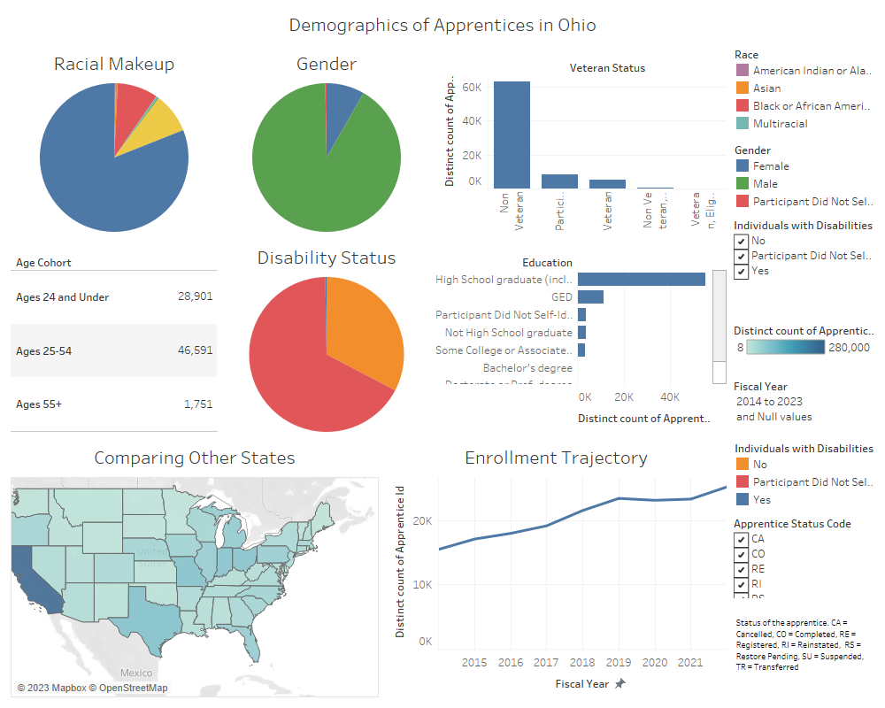
Notes:
Demographic Dashboard – Historic
Methodology
Big picture demographics in Ohio, help us understand what the typical apprenticeship looks like
In 2023, Majority of apprentices in Ohio were white, male, 25-54, did not identify as disabled, had a GED, and were non-veterans

Slide 8
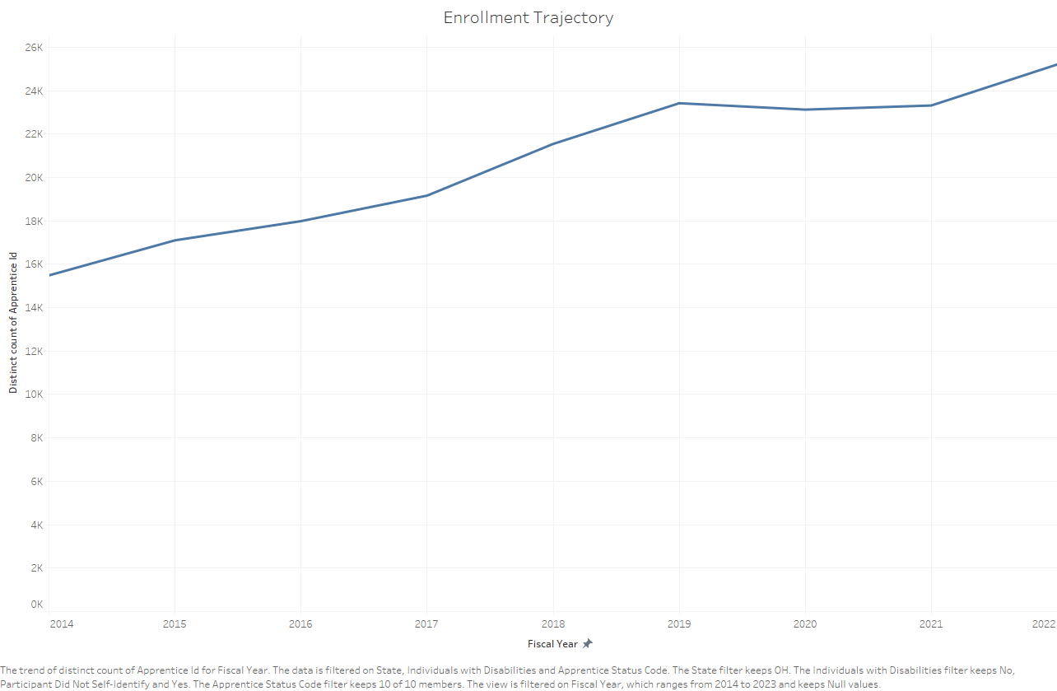
Active Apprenticeship Enrollment
Notes:
Overall number of active apprentices in Ohio increases
From 2022 to 2013, 78% increase (Department of Labor)

Slide 9
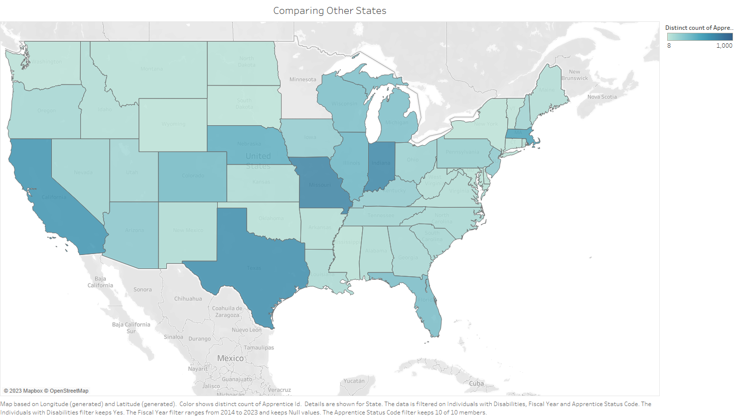
Individuals with Disabilities in Apprenticeships
Notes:
Across the country, people who self-identify as having a disability are underrepresented in apprenticeship programs
Partly attributed to reporting errors
Reporting started in 2014
In 2023, 84 active apprentices in Ohio self-identify as having a disability
Still, about 41% don’t self-identify at all
Some states are doing better (whether its reporting or having inclusive apprenticeships is unclear) – Indiana has 426 in 2023 and steadily increasing

Slide 10
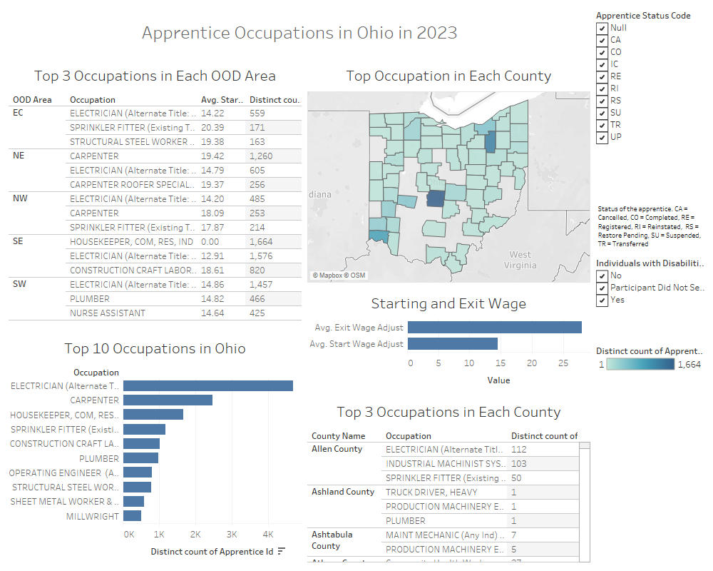
Notes:
Occupations Dashboard

Slide 11
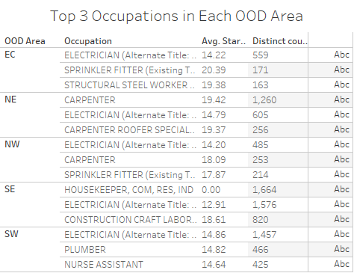
Notes:
Apprentice Occupations by Region and Wage
According to Department of Labor average wage for apprentices in Ohio in 2023 is $17.45 an hour
Apprentice wages go up as they go through the program
Does vary from program to program and region to region
In every region, electrician was in the top 3 occupations based on the number of apprentices
Other common occupations are carpenters and plumber/sprinkler fitter
Top 3 by number of apprenticeships are relatively similar across regions
Also produced more in-depth dashboard for each region

Slide 12
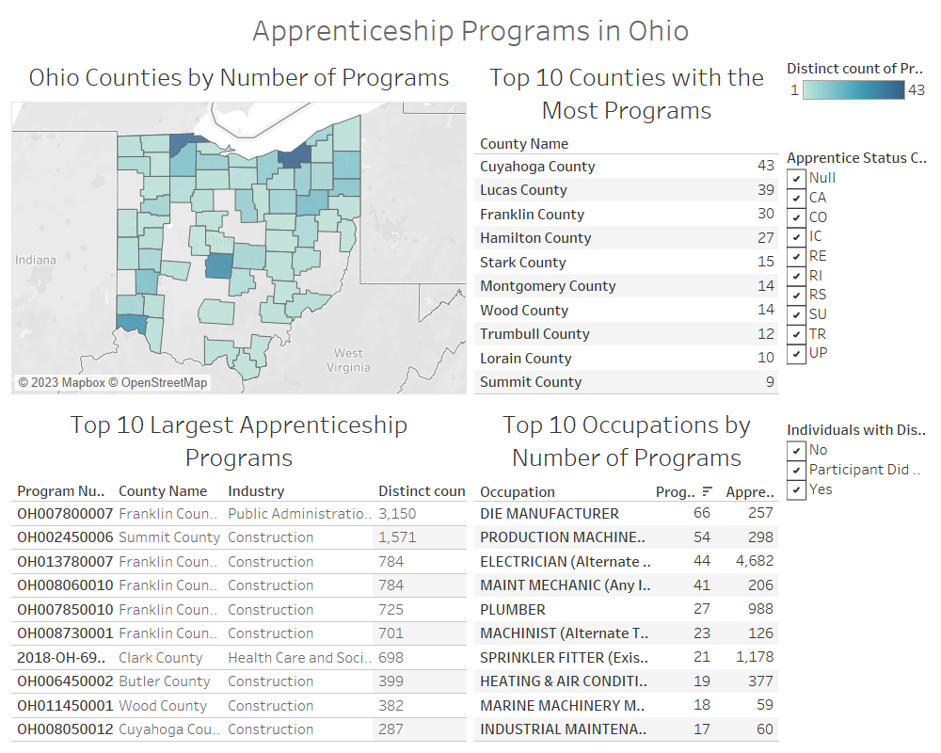
Notes:
Overview of apprenticeship programs in Ohio by industry, occupation, location

Slide 13
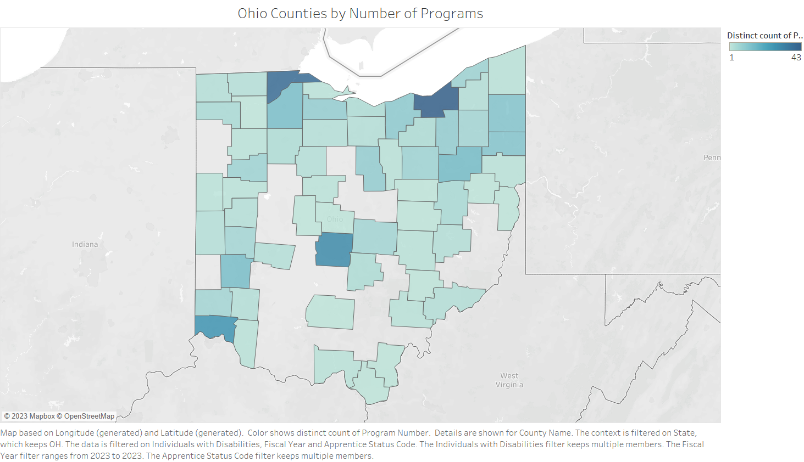
Notes:
Some Ohio counties do not have apprenticeship programs
However, apprentices come from all 88 counties, indicating apprenticeship programs are reasonably geographically accessible to residents in all counties

Slide 14
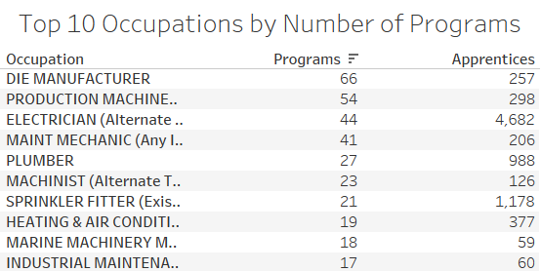
Notes:
Apprenticeship programs vary in size (although die manufacturers have the greatest number of programs out of any occupation, they only have 257 apprentices)

Slide 15
Data Preparation
Matched county to OOD region using VLOOKUP in Excel
Took first two digits of SOC code in Python
Used Kmodes to create clusters of two categorical variables, SOC code and OOD region
Notes:
Deidentified RAPIDs
Data blending to see overlap, mostly focused on apprenticeship through the lens of OOD mission
Most visualizations in Tableau, some data cleaning in Excel, dipped my toes into some machine learning for analysis in Python

Slide 16
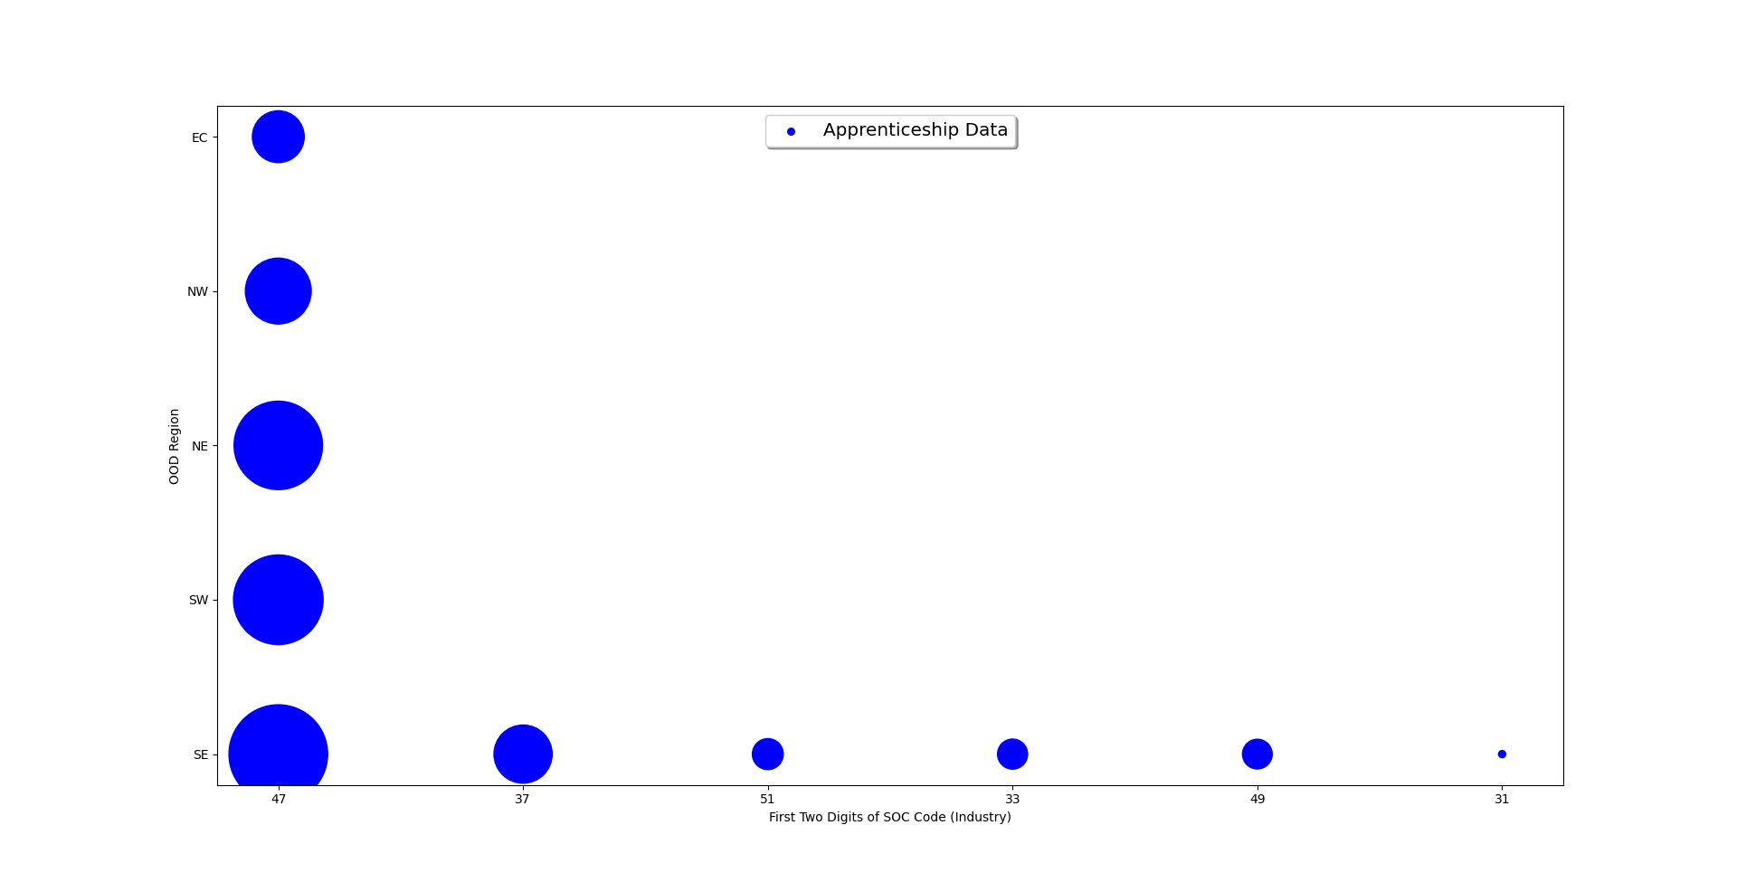
2023 Ohio Apprenticeship Data Cluster Analysis
47 = Construction and Extraction Occupations, 37 = Building and Grounds Cleaning and Maintenance Occupations, 51 = Production Occupations, 33 = Protective Service Occupations, 49 = Installation, Maintenance, and Repair Occupations, 31 = Healthcare Support Occupations
Notes:
Cluster analysis in Python
Used machine learning to group participants in apprenticeship programs based on their OOD region and first two digits of SOC code
Each dot represents the number of apprentices with the corresponding region and industry

Slide 17
Data Matching
Matched apprenticeship occupations to SOC code occupations
Imported both datasets into Tableau
Filtered data to include only apprenticeable SOC codes

Slide 18
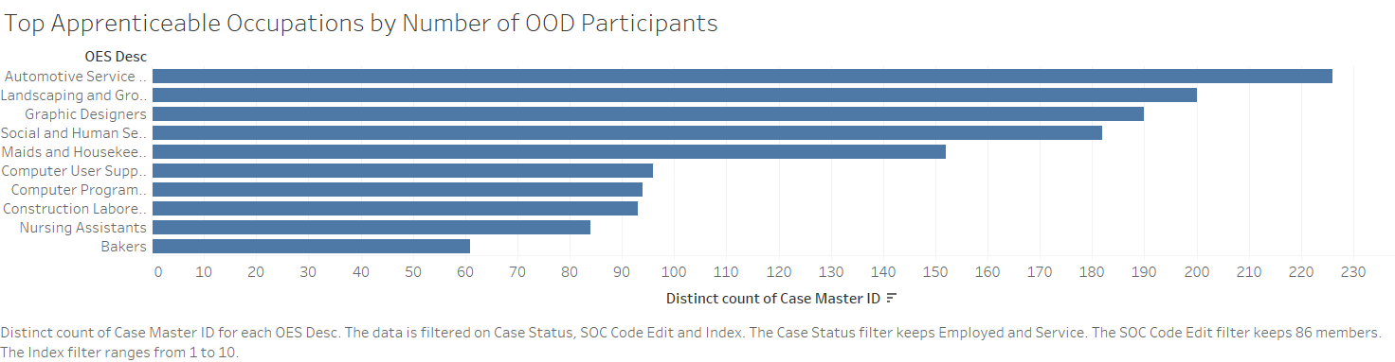
Participant Overlap

Slide 19
Further Research
Investigate pre-apprenticeship programs
How have other states integrated apprenticeship programs into vocational rehabilitation?
Contact target apprenticeship programs and ask about accommodations for individuals with disabilities
Notes:
Pre-apprenticeship programs are promising because they allow high school students or other people not ready to commit to an apprenticeship program the opportunity to experiment with a new occupation
Do states with high numbers of individuals who self-identify as having a disability in apprenticeship programs (like Indiana) coordinate with vocational rehabilitation? What have they done to make apprenticeships more inclusive?
Apprenticeships are sometimes hard to study because they are so heterogenous. Different programs may have different expectations for their apprentices. To confirm the program can make accommodations and be a welcoming environment, OOD should reach out to them directly

Slide 20
Conclusion
Majority of apprentices in Ohio were white, male, 25-54, did not identify as disabled, had a GED, and were non-veterans
2,455 current OOD VR participants have an IPE aligned with an apprenticeable occupation
Based on cluster analysis, “hotspots” for apprenticeship programs in construction in each region, other industries in Southeast region
Notes:
https://ohiomeansjobs.ohio.gov/job-seekers/practice-your-skills/occupation-search

Slide 21
Recommendations
Use website to search programs
Flag apprenticeable SOC Codes
Alert counselors who have participants with apprenticeable SOC code and program in region
Reporting mechanism for participants who enroll in apprenticeship programs
Monitor progress and enrollment
Notes:
https://ohiomeansjobs.ohio.gov/job-seekers/practice-your-skills/occupation-search

Slide 22
Thank you!

