Slide 1


OHFA and OERC Data Visualizations/Analysis By Elizabeth Yirava

Slide 2
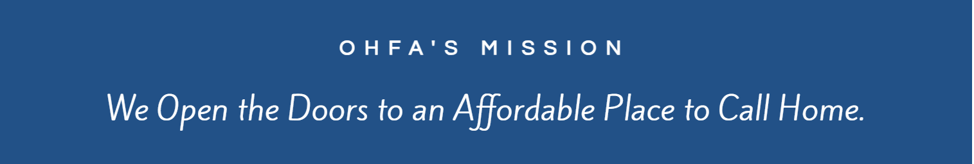
Attended team meetings
Learned about current projects
Introduced to Tableau + GIS
Notes:
Went to board meetings, team meetings, data warehouse and individual project meetings
Learned about what the rest of the team was working on, including an analysis of a particular company’s properties, QAP work, and the housing needs assessment
Became familiar with new softwares, such as tableau for visualizations, and was introduced to some of the team’s prior work in GIS

Slide 3

QAP Education Maps
Qualified Action Plan (QAP) used to determine criteria for selecting housing tax credit awards
Maps based on ODE report card data
Show attributes of different school districts
Info could be used to design school criteria for QAP

Slide 4
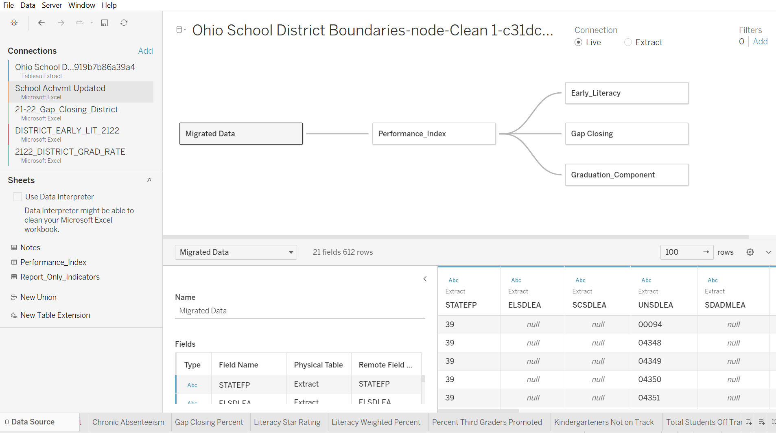
Data Source
Process: obtained file for district boundaries through National Center of Educational Statistics (NCES)
  Cleaned in tableau prep- removed unnecessary values, manually changed some district boundaries
ODE data: corrected names of school districts (spelling errors, variations in hyphens, prefixes)
Connected NCES by district name to ODE, ODE to rest of data by district IRN

Slide 5
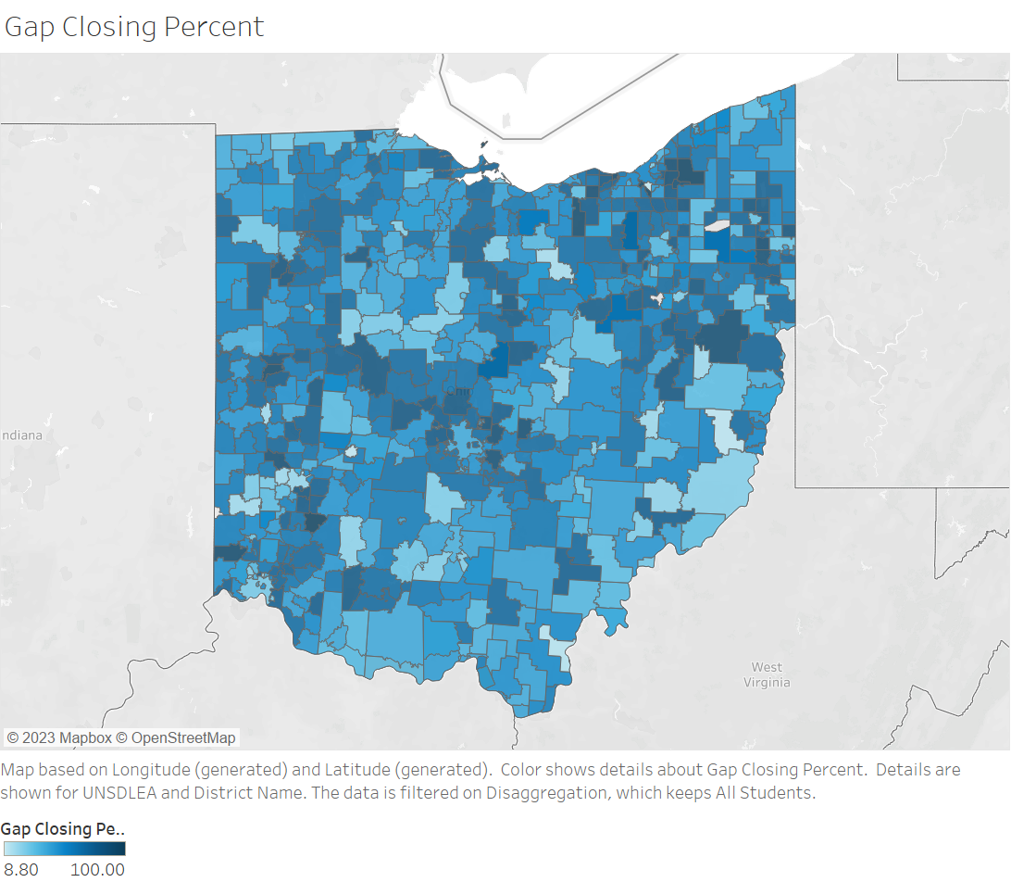
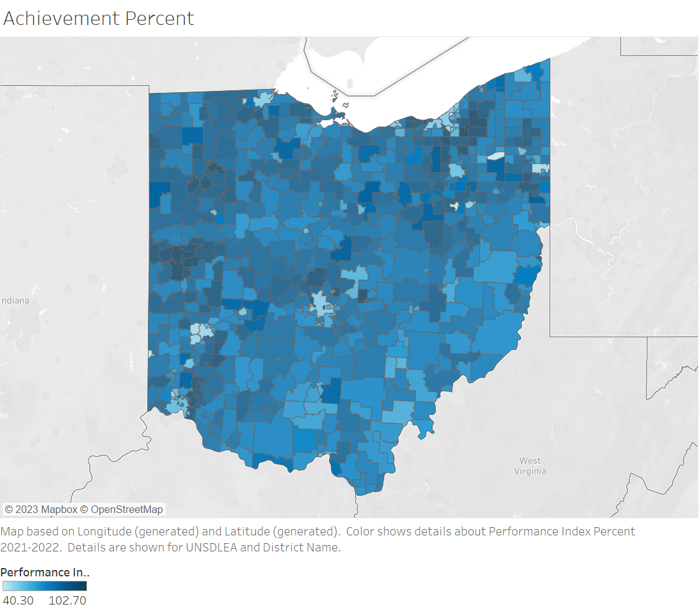
Student Performance Comparison
Notes:
Created maps by school district showing the different criteria on ODE report card data
More variation in gap closing than achievement
In some areas, only certain groups of student (non minorities) are achieving

Slide 6
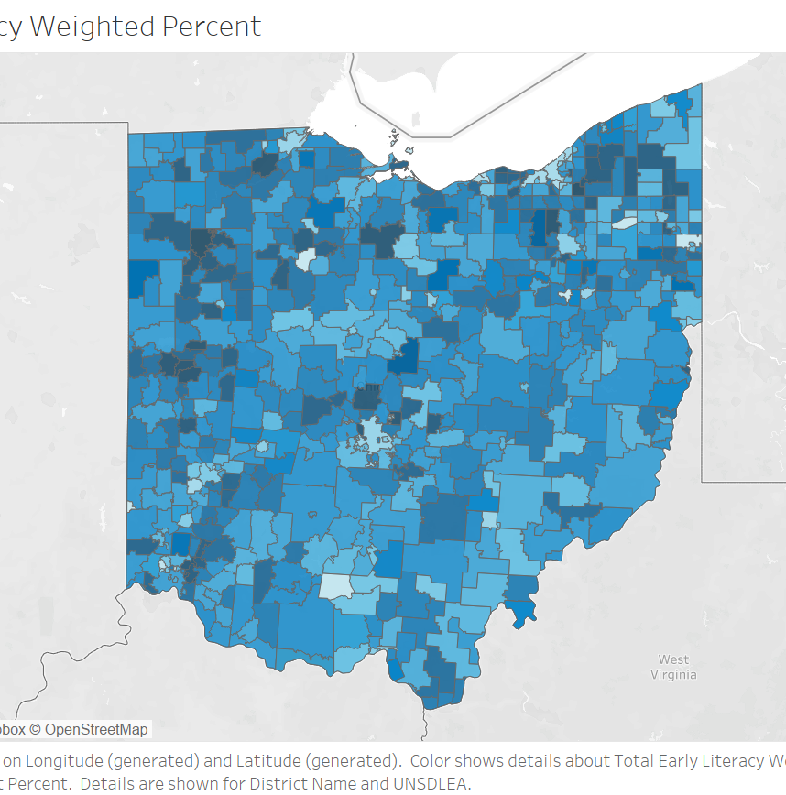
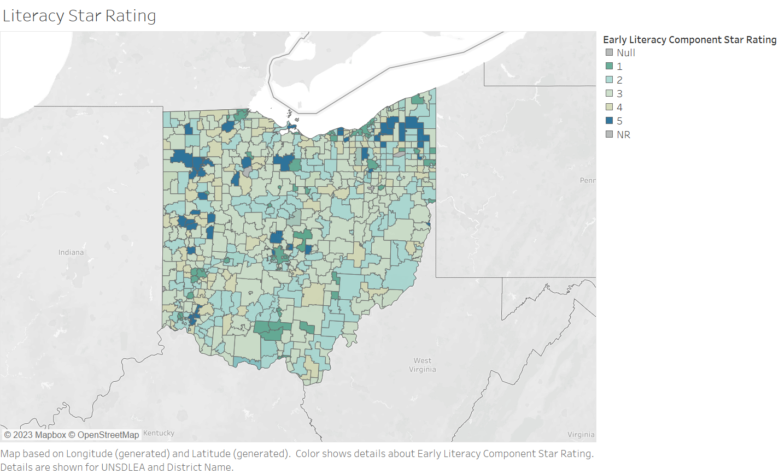
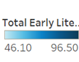
State Literacy Data
Notes:
Comparison between weighted percent and star rating
Districts with lower star ratings have more variation in percent literacy
Limited 5 star ratings distributed

Slide 7
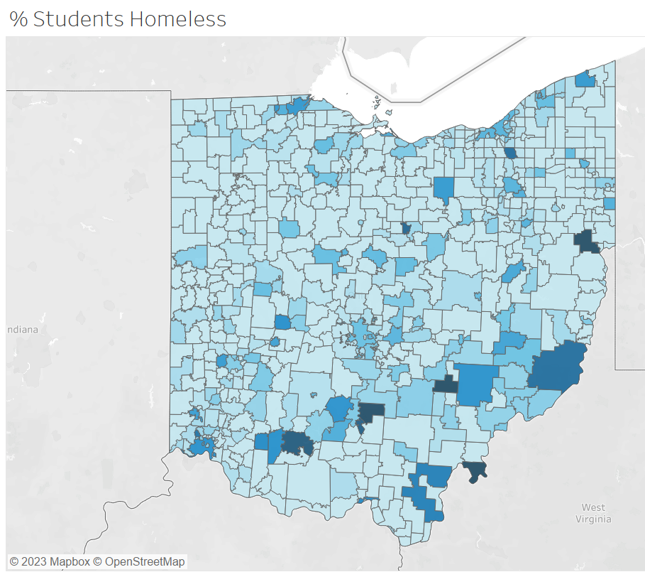
Other Maps
Achievement Rating
Achievement Percent
Chronic Absenteeism
Gap Closing Percent
Literacy Weighted Percent
Percent of Third Graders Promoted
Kindergarteners Not on Track
Total Students Off Track
Graduation Rate
Graduation Star Rating
Students Experiencing Homelessness

Slide 8
OERC Higher Education Employment Data

Slide 9
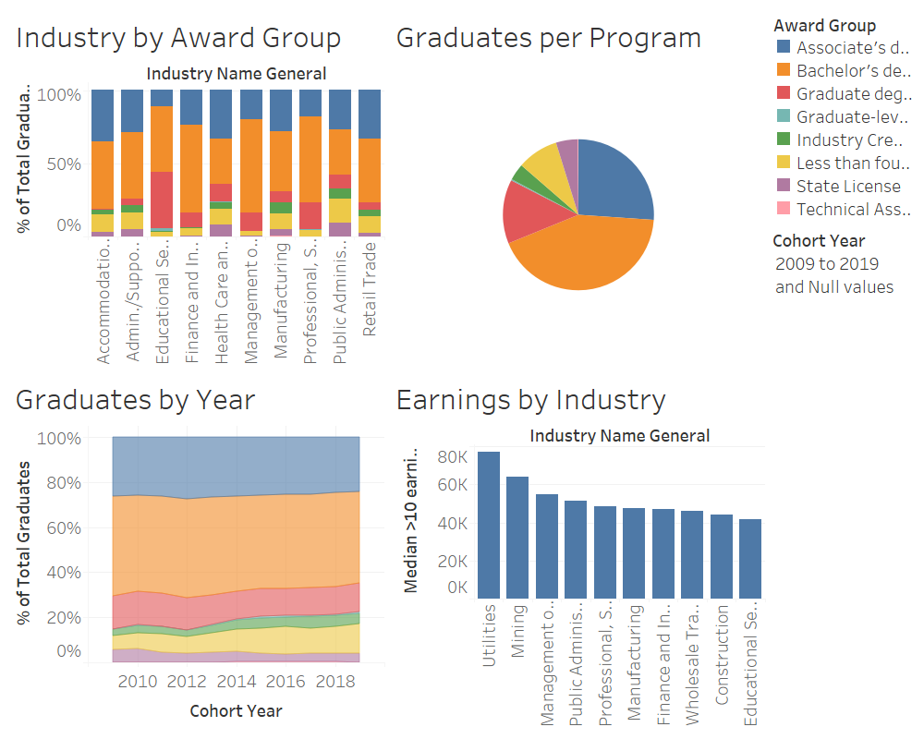
General Demographic Findings¹
Similar to existing dashboards
Common industries associated with each award
Number of awards in each category earned
Changes in distribution of awards over time
Highest earning industries
Notes:
Industry by award group – can also see breakdown of cohort year in the graph. Large amount of graduate degrees in education services, lots of bachelors degrees in mgmt. of companies
Increase in less than four year programs
Mining is very lucrative

Slide 10
Are Top Industries Also The Most Lucrative?
Very weak negative relationship (correlation) between industry distribution and earnings
Notes:
Relationship between the number of graduates in each industry and the average earnings of the top industries
Are the most lucrative industries the most popular?
Not necessarily – mining and utilities
Mgmt of companies does fit

Slide 11
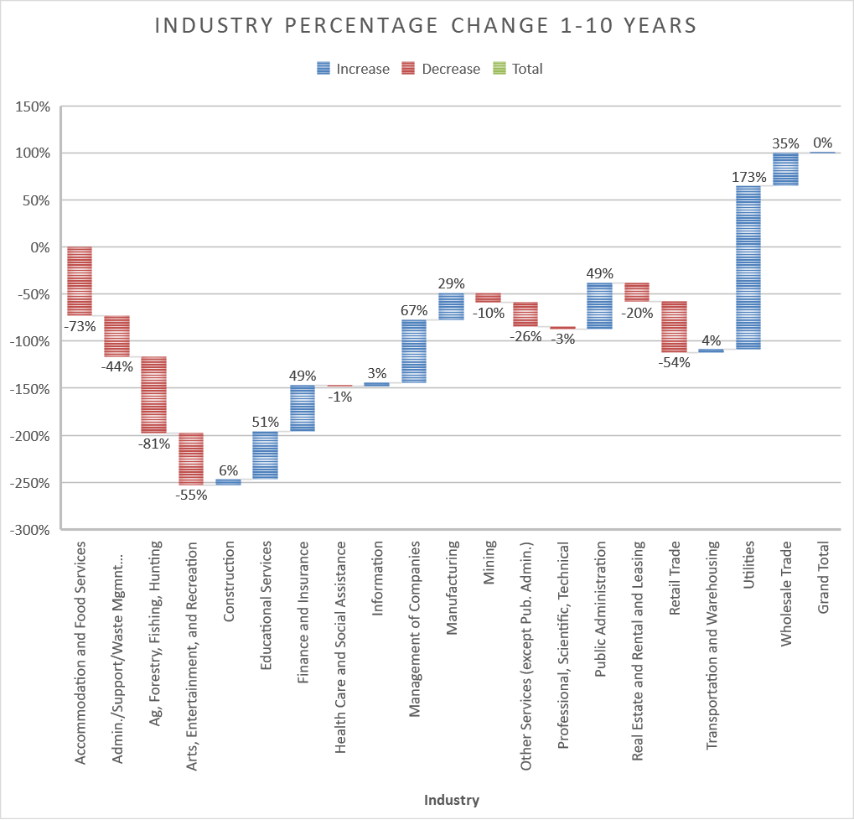
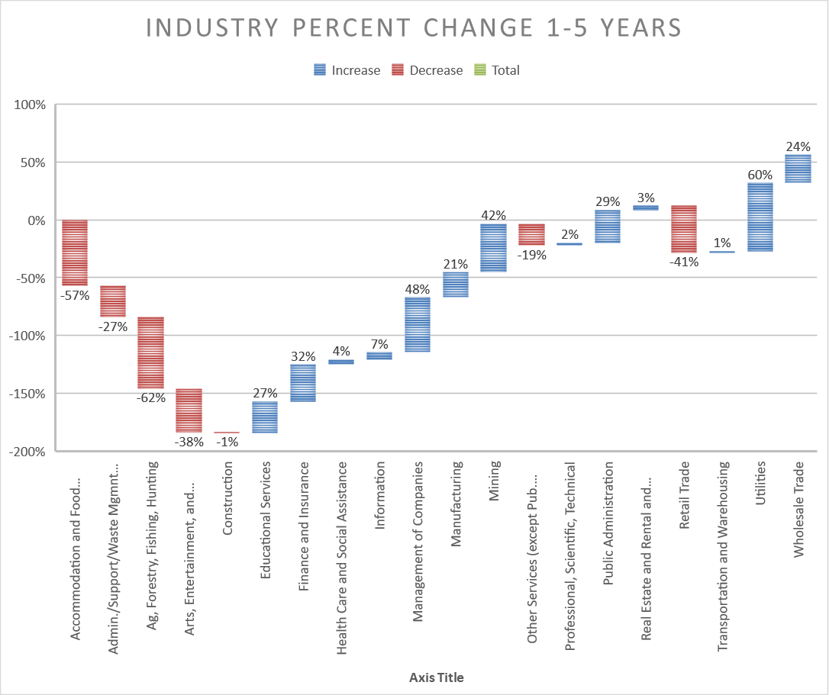
Evolution of Different Career Paths²
Notes:
% change in % of total graduates from each cohort of yrs. Past graduation from 1 yr to 10yrs
How graduates participate in different industries as their careers progress
Accomodation and food services + warehousing decrease

Slide 12
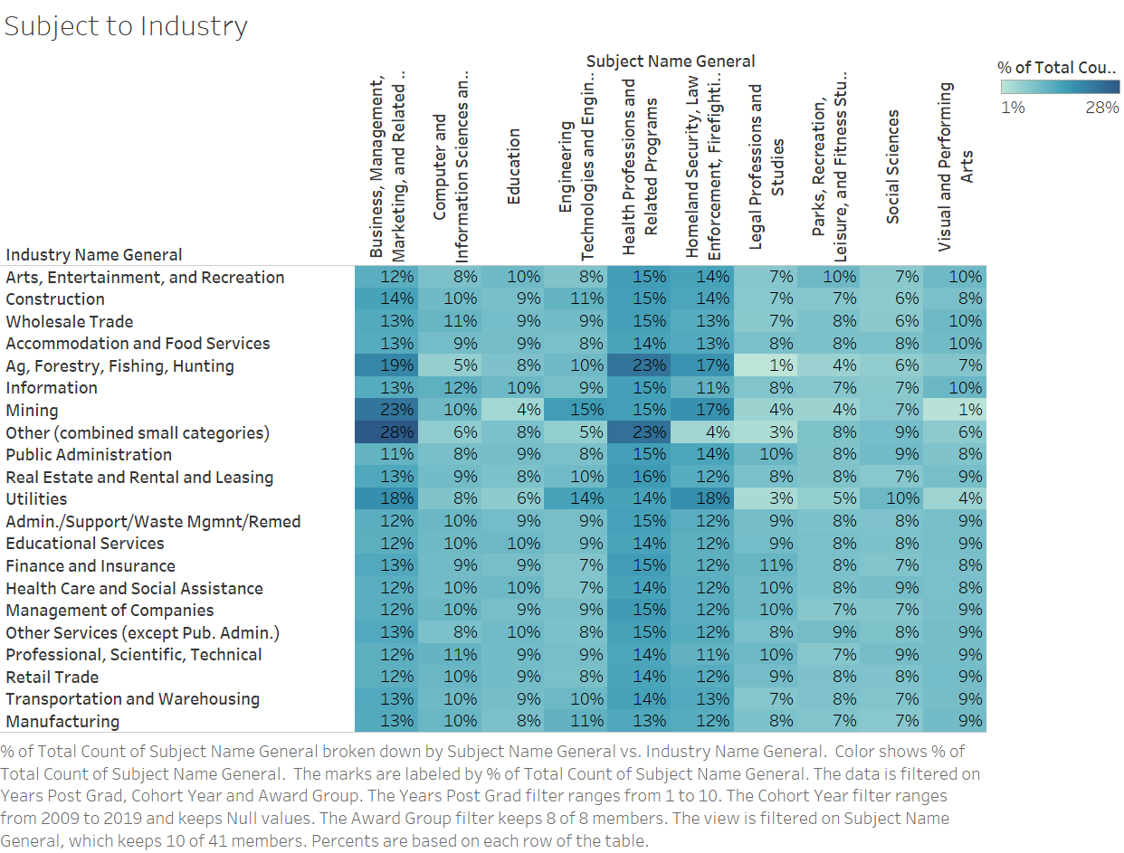
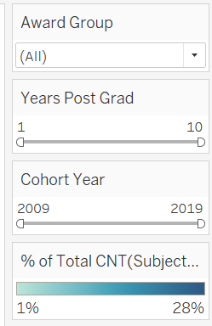
Relationship Between Degree Subject and Industry

Slide 13
Further Research
Relationship between award and outcome
Breakdown of graduate demographics
How Ohio colleges/programs influence degree and industry outcomes
Scholar housing and education data

Slide 14

The End!
Thank you!

Slide 15
Appendix & Questions

Slide 16
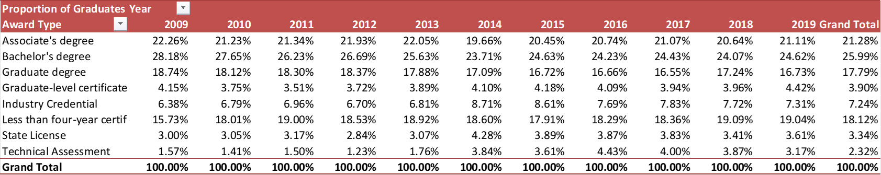
1. Distribution of Awards

Slide 17
2. Percent of Total Graduates in Each Industry
Notes:
Underlying data from last graph
% of total graduates from each yrs from graduation cohort in each industry
Health care pretty stable
Food services dec.

