Slide 1


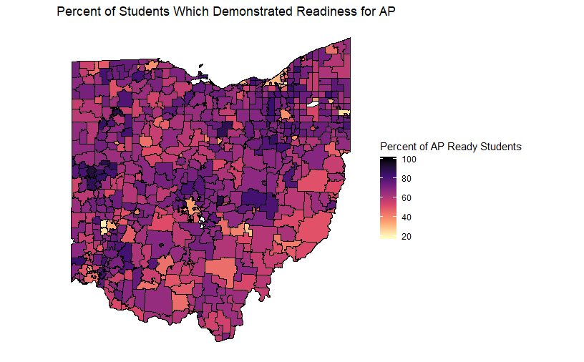
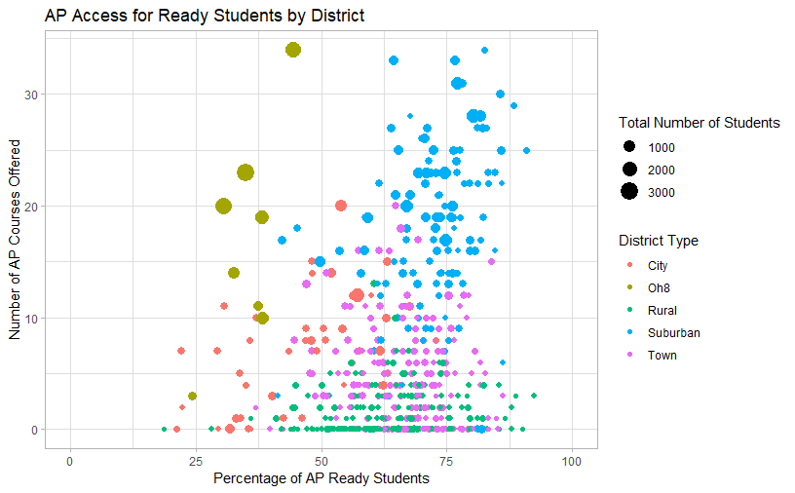
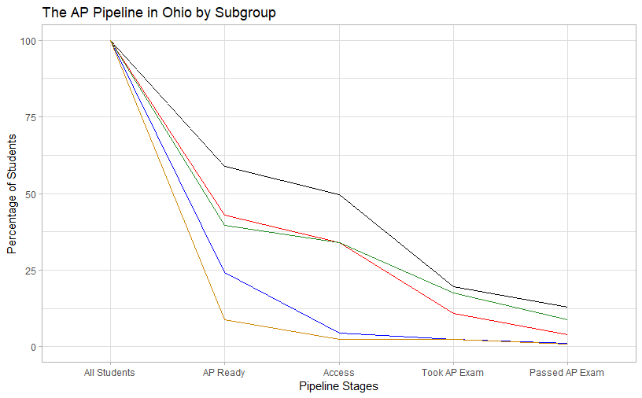
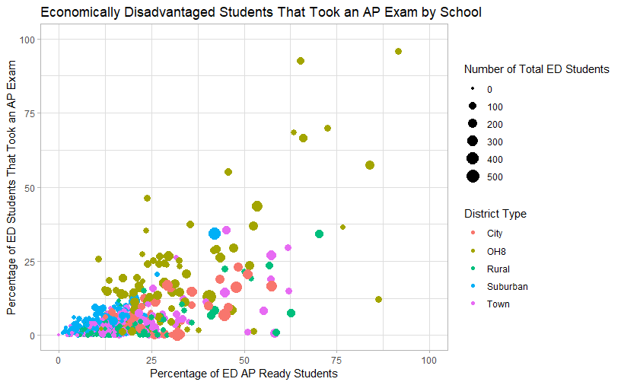
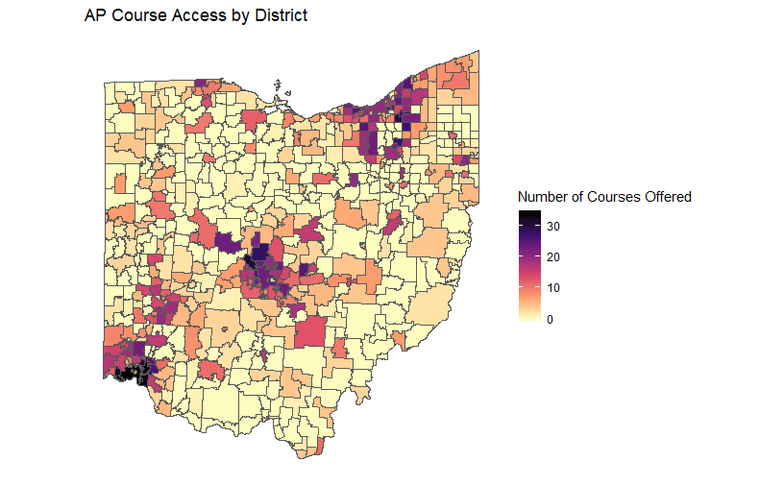
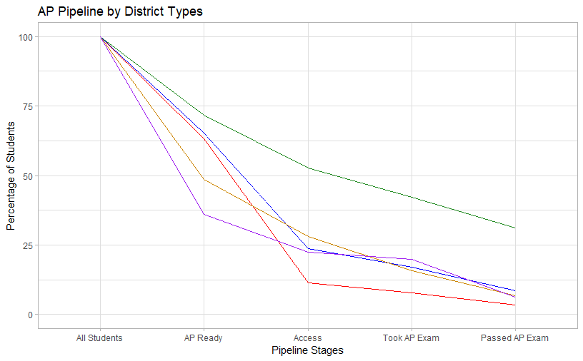
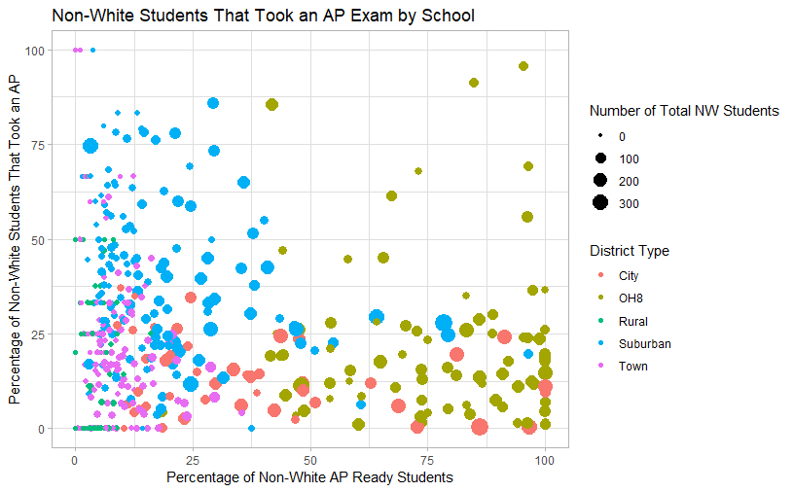
AP Access and Equity in Ohio Schools: An Exploratory Analysis
Maddie Dewhirst, John Glenn College of Public Affairs, The Ohio State University
INTRODUCTION
The Advanced Placement (AP) program created by the College Board allows high school students to take certain courses at a higher, college level, while still in high school, with the intent of earning some college credit by passing a final exam at the end of the course. Due to the ability to earn college credit in high school, an increase in access to the AP program would allow for more students to save money before entering college.
This data comes from the 2018 graduation cohort, meaning the following analyses are based solely on students in their fourth year of high school and the school they were reported to be in at that time.
District Maps
District Plot
FINANCIAL OUTCOMES
Based on an average tuition for full-time, main campus, public universities in Ohio, a typical 3 credit hour course costs $815.31. The average AP student passes 3 courses in their high school career. This makes their on average college savings $2,445.93 based on taking AP courses. This is more than half of one semester worth of tuition.
With just under half of the 2018 cohort having access to AP courses in high school, there is a large number of students that could be saving more in college if the AP program was an option.
Percent of Students That Demonstrated Readiness for AP
AP Access for Ready Students by District
Total Number of Students
Percent of Students that Demonstrated Readiness
Number of Unique AP Exams
District Type
CONCLUSIONS
From the analyses and visualizations conducted, there is a clear disparity between certain subgroups and geography in Ohio compared to the state as a whole.
There is a decrease in access and participation for students who are Economically Disadvantaged or Non-White. Similar results are seen for districts of Rural and Town typography. These are the populations that need the most attention in order to increase access and equity for all students.
RESULTS
Percentage of AP Ready Students
Pipeline Graphs
School Plots
The AP Pipeline in Ohio by Subgroup
All Ohio Students
Economically Disadvantaged Students
Non-White Students
Students with Disabilities
English Learners
Economically Disadvantaged Students That Took an AP Exam by School
Count of Unique AP Course Exams Taken
Total Number of ED Students
Percentage of Students
Number of AP Course Exams
Percentage of ED Students That Took an AP Exam
District Type
POSSIBILITIES FOR FUTURE WORK
There were some limitations to this data that call in additional questions for research.
The first being that the students in the 2018 cohort were only recorded for the high school and district of their graduation cohort. This means that some students could have taken an AP somewhere else but it was reported for that one school. By incorporating course data along with the AP test data, a more precise analysis could be conducted.
Another area to look into would be to compare AP participation with other college credit/preparedness programs such as College Credit Plus. There is a possibility that though some student populations aren’t taking AP courses, they are still eligible to take some form of college level coursework.
Pipeline Stages
Percentage of ED AP Ready Students
The AP Pipeline by District Type
Rural Districts
Town Districts
Suburban Districts
City Districts
Ohio 8 Districts
Non-White Students That Took an AP Exam by School
Count of Unique AP Course Exams Taken | Number of Districts | Percentage of Districts
0 | 184 | 30.5%
1-10 | 281 | 46.5%
11-20 | 91 | 15.0%
21-30 | 42 | 7.0%
30+ | 6 | 1.0%
Total Number of NW Students
Percentage of Students
Percentage of NW Students That Took an AP Exam
District Type
Bibliography
ODE 2018 Graduation Cohort and AP Data
ODHE College Tuition Costs Data-from website
Pipeline Stages
Percentage of NW AP Ready Students
Acknowledgements:
Special thanks to the Ohio Education Research Center and the Ohio Department of Education for all of the support during this summer internship program. I would like to specifically thank
Dr. Josh Hawley for facilitating the program and Eben Dowell for being so helpful throughout my project.
MAKING RESEARCH WORK FOR EDUCATION www.oerc.osu.edu | connect@oerc.osu.edu

