Slide 1

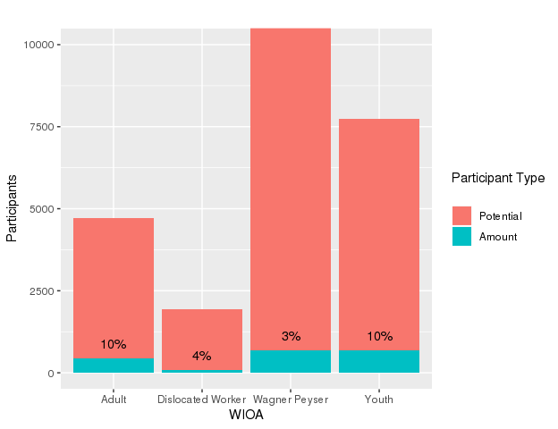
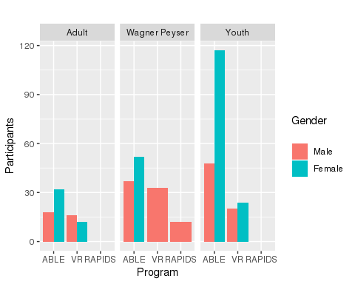
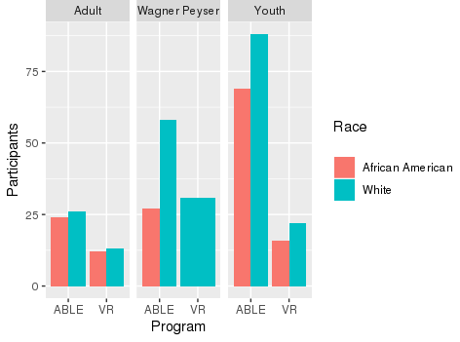
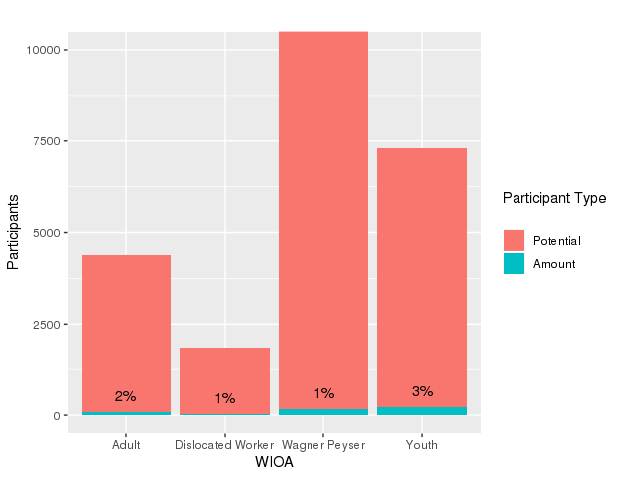
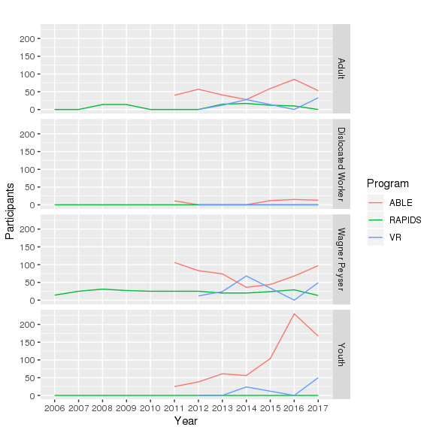
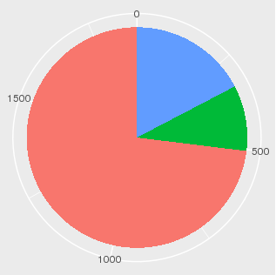
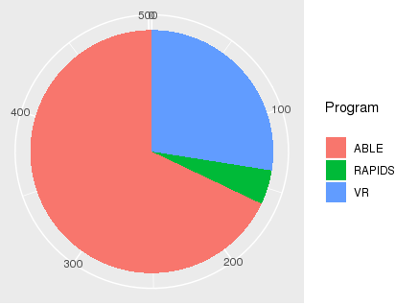

Co-Enrollment in Workforce Programs: An Exploratory Study James Schiering, Daniel Rizo-Patron, Ohio Department of Jobs and Family Services
INTRODUCTION
The results in this document come from the OLDA data and include the datasets: ABLE, Vocational Rehabilitation (VR), PIRL, and RAPIDS. Using this data I have analyzed the levels of Co-Enrollment between the programs along with variables such as Gender and Race.
RESULTS
Percentage of participants co-enrolled overall: 5%
Percentage of participants co-enrolled in 2017: 1%
Percentage of participants co-enrolled by WIOA program: Adult: 10%
Dislocated Worker: 4%
Wagner Peyser: 3%
Youth: 10%
Percentage of participants co-enrolled by WIOA program in 2017:
Adult: 2%
Dislocated Worker: 1%
Wagner Peyser: 1%
Youth: 3%
Co-enrolled demographics:
On average 50% more females than males
On average 40% more Whites than African Americans
Percentage of Overall Participant co-enrollment Amount vs. Potential
Total Gender and Race Amount by PIRL, ABLE, VR, and RAPIDS for 2017 co-enrollment
AIM
This is an exploratory analysis of co-enrollment between the PIRL, ABLE, VR, and RAPIDS programs done to answer a few questions:
Does co-enrollment exist
What is the level of co-enrollment
What are the social-demographic elements
What is co-enrollment now compared to the past
Percentage of 2017 Participant co-enrollment Amount vs. Potential
METHODS
Starting with PY 2017 PIRL data, I separated each participant into the four WIOA subgroups and remove any who are not in those groups. Next I left join in all of the ABLE, VR, and RAPIDS data by SSN_PID to test for co-enrollment. I did some percentage analysis of this overall data before limiting it to the year 2017 to get number for actual co-enrollment for that year. I made some percentage and demographics analysis on this 2017 data.
Amount of Participants in PIRL 2017 also in ABLE, VR, or RAPIDS by File Year
Total Amount of PIRL co-enrollment in ABLE, VR, and RAPIDS
RECOMMENDATIONS
This exploratory analysis has provided a general outline of co-enrollment that should definitely be followed up with a more in depth and intensive study. A good focus for the next study would be look at all the years individually and how those parts interact with the whole.
CONCLUSIONS
Overall
The amount of co-enrollment overall is a respectable number but the actual year by year amount is very small. Though the amount of co-enrollment is increasing in recent years
2017
The year 2017 made up about 1/5 of the overall co-enrollment numbers; numbers that were taken from 5 (VR), 6 (ABLE), and even 11 (RAPIDS) years ago till now. This shows that this year at least has seen a significant increase in the amount of co-enrollment between PIRL, ABLE, VR, and RAPIDS.
Overall
ABLE: 1,366
VR: 324
RAPIDS: 180
2017
ABLE: 341
VR: 138
RAPIDS: 23
Note: All instances of “0” in the graph means that the amount was between zero and ten and was thus not reported.
MAKING RESEARCH WORK FOR EDUCATION www.oerc.osu.edu | connect@oerc.osu.edu

