Slide 1
From Unemployment to Reemployment: Tracking Ohio UI Claimants
Tian Lou, Ph.D.
Ohio Education Research Center
CHRR at The Ohio State University
C2ER/LMI Institute Annual Conference
June 15, 2022

Slide 2
Ohio Business Shutdown and Reopen Timeline
March 17, 20
Elective surgeries and procedures were postponed
March 23, 20
April 24, 20
May 21, 20
March 15, 20
Elective surgeries resumed
Bars and restaurants reopened for dine-in.
Bars and restaurants closed.
Stay-at-home order became effective
March 9, 20
March 16, 20
March 23, 20
May 1, 20
First three COVID cases found in Ohio
K-12 schools closed
Some senior centers and adult day care stopped providing service.
Stay-at-home order expired and was replaced by Responsible Restart Ohio Plan
Notes:
Summary of timeline: https://www.huschblackwell.com/ohio-state-by-state-covid-19-guidance

Slide 3
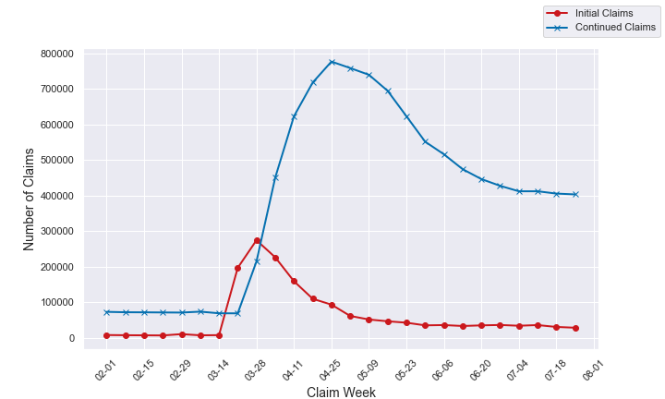

Slide 4
Tracking Claimants Over Time
Of people who started to collect UI benefits between March and May 2020:
During each week after the first continued claim, what percentage of them continued to collect UI benefits?
During each quarter after the first continued claim, what percentage of these people 1) only collected UI benefits, but did not work, 2) only worked, 3) collected UI benefits and worked, and 4) neither collected UI benefits nor worked?
How do the trends vary by cohort?
How do the trend vary by industry?
The method is inspired by Coleridge Initiative IL Unemployment Insurance Claims Dashboard

Slide 5
Data
Ohio RAS (residency assignment system) data
Same as PROMIS file
Does not include PUA (Pandemic Unemployment Assistance)
This analysis focuses on regular state UI claims
Three cohorts:
Pandemic Cohort: started UI benefits between March and May 2020
Pre-Pandemic Cohort: started UI benefits between March and May 2019
Post-Pandemic Cohort: started UI benefits between March and May 2021
UI Wages Records and QCEW data
Employed: Quarterly total earnings >= $100
Industry of the employer that paid a person the most during a quarter

Slide 6
Definitions of Week
Cumulative week |  |  | Actual week
person | Claim week | Cumulative week | person | Claim week | Actual week
1 | 03-14-2020 | 1 | 1 | 03-14-2020 | 1
1 | 03-28-2020 | 2 | 1 | 03-28-2020 | 2
2 | 03-14-2020 | 1 | 2 | 03-14-2020 | 1
2 | 04-25-2020 | 2 | 2 | 04-25-2020 | 7

Slide 7
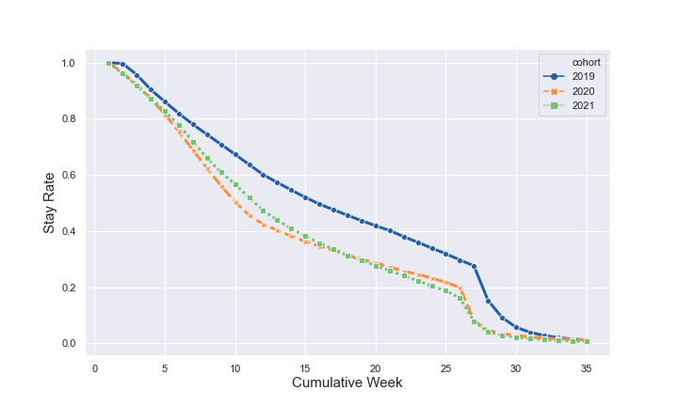

Slide 9
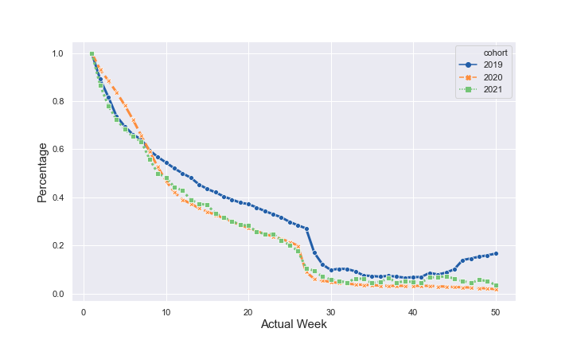

Slide 11
Combine UI Claims and UI Wage Records
The UI claims data does not tell us whether a person stopped receiving UI benefits because he/she
stopped looking for a job
voluntarily stopped receiving benefits
went back to work
Combine UI claims and UI wage records and define UI status as:
only collect UI benefits
only work
collect UI benefits and work
neither collect UI benefits nor work?
Trade-off:
Switch from weekly data to quarterly data
two quarters of data lag

Slide 12
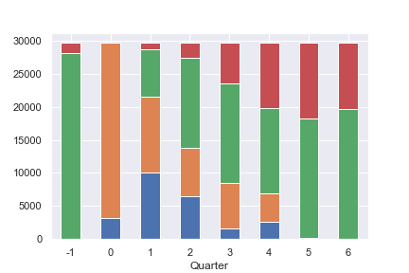
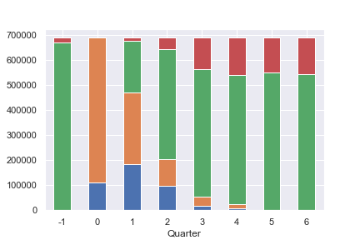
2019 Cohort
2020 Cohort

Slide 13
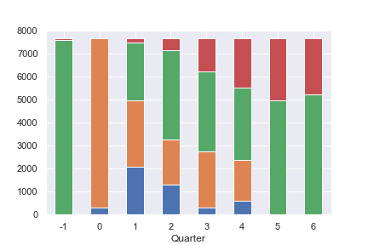
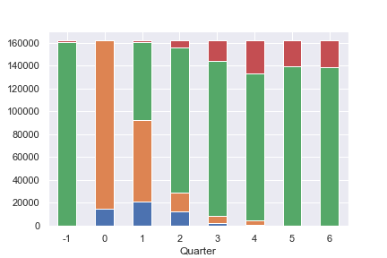
2019 Cohort
2020 Cohort

Slide 14
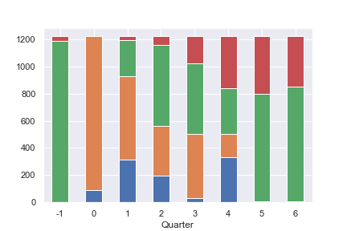
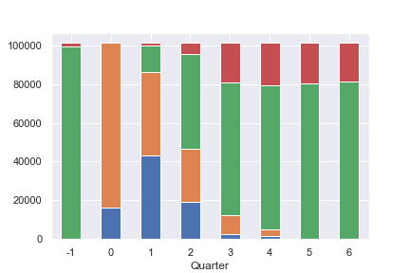
2019 Cohort
2020 Cohort

Slide 15
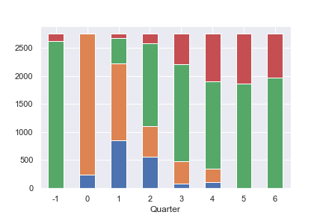
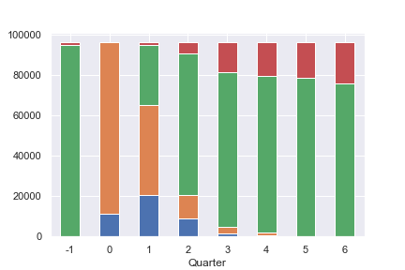
2019 Cohort
2020 Cohort

Slide 16
Appendix

