Slide 1
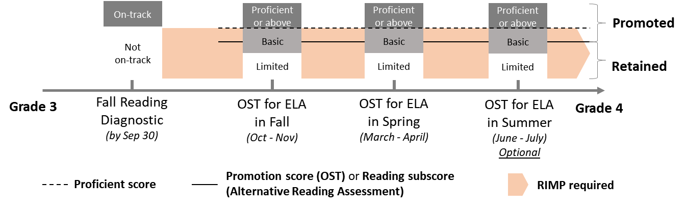
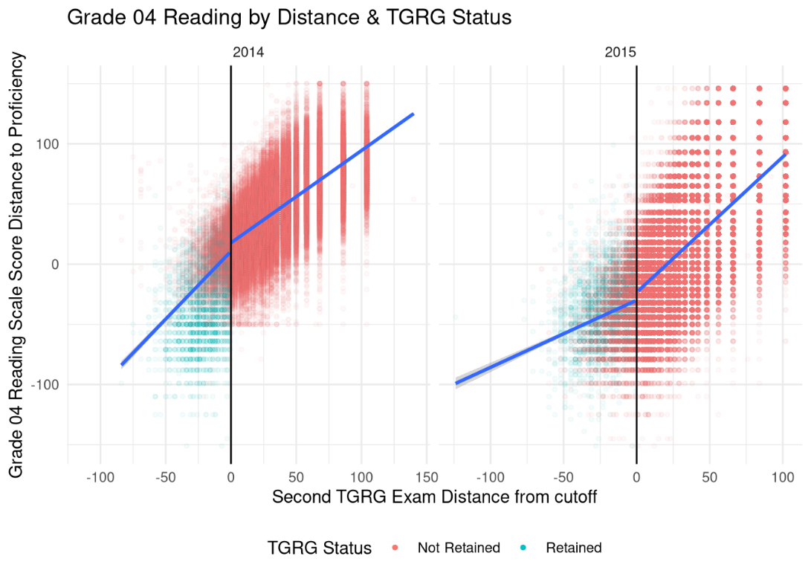
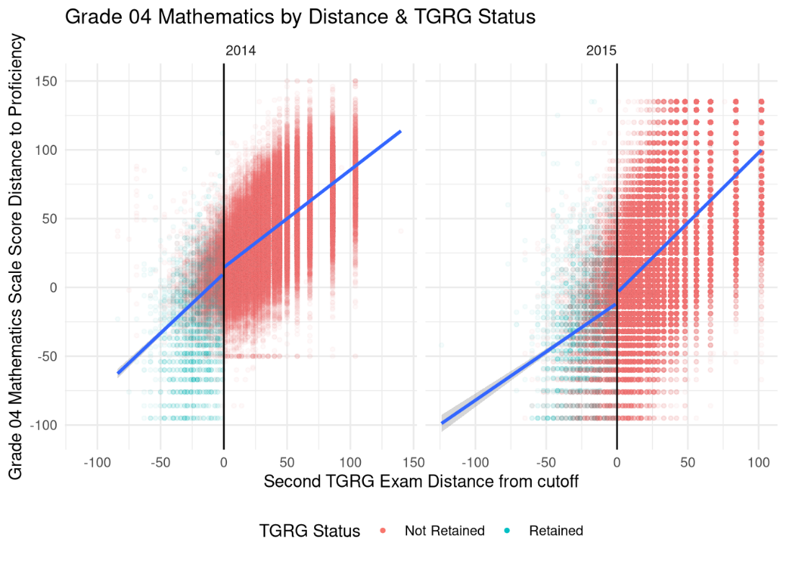
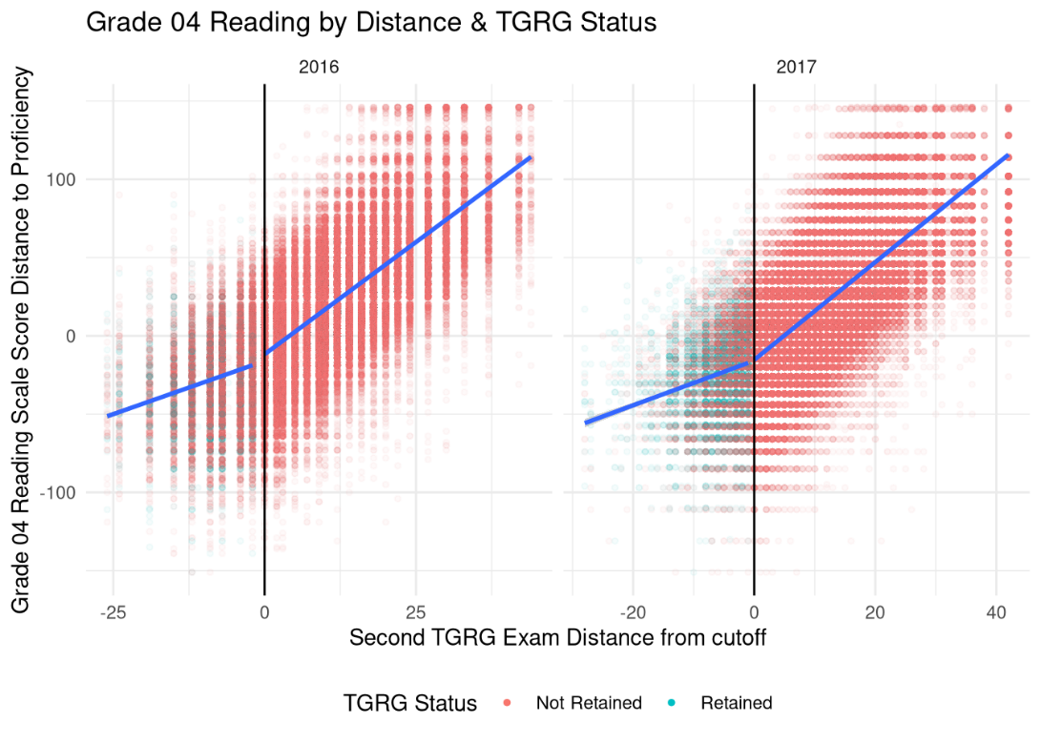
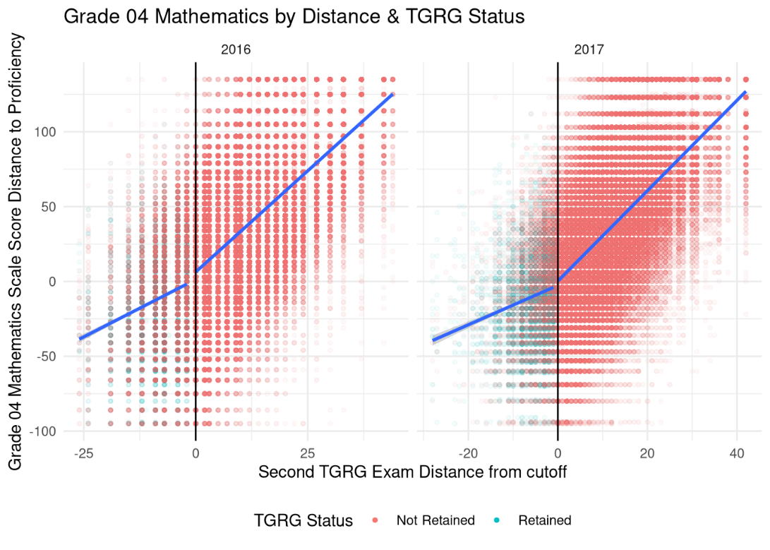






Evaluating Ohio’s Third Grade Reading Guarantee Program
with a Regression Discontinuity Design
Tian Lou*, Seong Ji Jeong**, Caroline Barto*, Anirudh Ruhil***, and Joshua Hawley*
*Ohio Education Research Center at Ohio State University, **Pennsylvania State University, *** Ohio University
Contextual Background
Data
Results
Conclusion
[Ohio’s Third Grade Reading Guarantee Program]
Ohio's Third Grade Reading Guarantee (TGRG) is a program designed to identify K-3 students struggling with reading and provide support to help them achieve reading success by the end of third grade.
Between the 2014 and 2023 school years, third graders who did not meet the promotion score on the English Language Arts (ELA) state test were required to repeat third grade, with exceptions for English language learners (ELL), students with disabilities, and those who had previously been retained twice.
  1-6 % of third graders did not meet the promotion score between the school years 2014 and 2021 (Ohio Department of Education and Workforce, 2024).
Scaled grade 3 ELA score is used to determine students’ eligibility for promotion to fourth grade and assess their level of performance.
  The promotion score is pre-determined and is set within the range of "basic“ (as shown in Figure 1).
Third grade students usually have two chances to take the state ELA tests. Students who achieve the promotion score or higher on either Fall or Spring ELA test will be eligible for promotion at the end of the school year.
  Starting in school year 2016, the reading sub-score is also used to determine promotion eligibility.
Starting in school year 2024, due to the change of state legislature, third-grade retention becomes optional. Parents can request for promotion to the fourth grade even if the student did not meet the promotion score.
[Controversy around grade retention]
Proponents:
  Grade retention can benefit academically disadvantaged students by giving them extra time to improve reading proficiency (Lynn, 1963).
  Reading proficiency will then serve as a foundation for learning other subjects in later grades (Hernandez, 2011).
Opponents:
  Grade retention can cause negative life events for students, such as social disapproval and stigmatization (Bos et al., 2013).
  The policy leads to more stigmatization among racial minority students and students from low-income families (Crothers et al., 2010).
  Empirical Evidence from Prior Research
  Prior research has evaluated retention policies in different states, using methods such as regression discontinuity and multi-level modeling.
    Positive: Florida (Schwerdt et al., 2017), Indiana (Hwang & Koedel, 2022), Chicago (Jacob & Lefgren, 2004), and Mississippi (Mumma & Winters, 2023) – short-term academic gains due to retention faded out over time; retention at an earlier grade is more beneficial than retention at a later grade level.
    Negative or Mixed: Florida (Özek, 2015) or Louisiana (Eren et al., 2017). – Increases in disciplinary incidences, suspension, and school dropouts
Data Source: Ohio Education Management Information System (EMIS), which includes Ohio public school students’ state test scores, retention outcomes, and demographic characteristics.
Sample Population: Third-grade students in Ohio public schools
  436,161 third graders between school years 2014 and 2017
  107,004 third graders in the analytical sample (just above or below the promotion scores)
Sample Restrictions: Everyone was subject to TGRG. Some of the students were exempted, including those who were English Language Learners (ELL), were in Individualized Education Programs (IEP), had cognitive disabilities, or were retained in the prior school years. In total, we took out about 9% of third graders from the sample.
Outcome measures: 4th to 8th grade ELA and math state test scores
We focus on how the policy affects students’ fourth to eighth grade English Language Arts (ELA) and math tests performance.
First, we find the TGRG has strong effects on both 4th grade English language Arts and math test performance. Specifically, for the students in the 2015-2017 cohorts who score near the cutoff point, the retained students score 31-50 points higher than the promoted students on the ELA test and 25-53 points higher on the math test.
Second, our results show persistent but fading effects over time for all four cohorts in both ELA and math tests. For example, the effect on ELA test scores for the 2014 cohort reduced from 23 points in 5th grade to 13 points in 7th grade, and the significance level reduced. The effect on math test scores is only significant in 5th grade (14 points increase) and becomes insignificant in the 6th grade and 7th grade.
Finally, for all four cohorts and during most of the years when the test data are available to us, the TGRG has a greater effect on ELA test performance than math test performance. For example, the 4th grade ELA effects are 15 points and 6 points higher than the 4th grade math effects for the 2015 and 2017 cohorts, respectively.
We found positive and persistent third-grade retention impacts on students’ ELA tests and math tests from grade 4 to grade 8, although the sizes of the positive impacts reduce over time.
  Our findings are consistent with prior research that uses data from other states (Jacob & Lars, 2004; Hwang & Koedel, 2022; Mumma & Winters, 2023; Schwerdt et al., 2017).
  Our findings suggest that the Third Grade Reading Guarantee program in Ohio effectively improved retained students’ academic performance.
The retention policy’s effectiveness is likely due to retained students usually being exposed to extensive reading supports, including:
  Teacher training: Teachers are required to have at least one year of teaching experience and should provide an intensive, comprehensive, and high-quality remedial program for children.
  Individualized RIMP: Schools are required to develop and monitor the individualized RIMP. Retained students are assigned to high-performing teachers through multi-tiered system of supports in reading instruction.
Given the recent changes in Ohio’s TGRG program and ongoing debates on TGRG, it is critical to objectively identify students who are most likely to benefit from retention.
  The exemption upon parents’ request may lead to differential enforcement of the policy, since parents from more advantaged backgrounds are more likely to advocate for avoiding their children’s retention (LiCalsi et al., 2019).
  Educators should provide resources on third-grade retention practices to students’ guardians to help them make informed decisions.
Future studies should investigate long-term student outcomes, including high school graduation, college enrollment, and labor market outcomes, as well as social-emotional or behavioral outcomes, such as school belonging, self-esteem, or classroom behaviors.
Table 1. Ohio Third Grader Demographic Characteristics
 | Above the promotion score | Below the promotion score | Difference
N | 78,473 | 28,531 | -
Female | 0.463 (0.499) | 0.453 (0.498) | 0.010** (0.003)
Asian | 0.014 (0.117) | 0.012 (0.109) | 0.002* (0.023)
Black/African American | 0.213 (0.410) | 0.296 (0.456) | -0.083*** (0.000)
Hispanic/Latino | 0.073 (0.260) | 0.085 (0.279) | -0.012*** (0.000)
Non-Hispanic White | 0.639 (0.4800 | 0.544 (0.498) | 0.095*** (0.000)
Other Races | 0.061 (0.239) | 0.063 (0.243) | -0.002 (0.218)
English Language Learners | 0.059 (0.236) | 0.072 (0.259) | -0.013*** (0.000)
Economically Disadvantaged | 0.667 (0.471) | 0.770 (0.421) | -0.102*** (0.000)
With Disability | 0.167 (0.373) | 0.162 (0.369) | 0.005* (0.046)
Figure 1. Ohio Third Grade Reading Guarantee Roadmap
Figure 2. Retained vs. Promoted Students’ 4th Grade Test Scores Distributions
Notes: The fall reading diagnostic assessment determines whether a student is “on-track” or “not on-track." A "Reading Improvement and Monitoring Plan” (RIMP) is required for “not on-track” students until they score “proficient” or higher on either the fall or spring Ohio’s State Test (OST) for ELA. Students who achieve the promotion score or higher on the state test (e.g., an ELA scaled score of 685 in 2022–2023) or the promoted sub-score or higher (e.g., a reading sub-score of 47 in 2022–2023) are eligible for promotion at the end of the school year with some exceptions, such as English Language Learners (ELL) or students with disabilities.
Methodology
(a). 2014 and 2015 Cohorts’ Grade 4 Reading Test Scores
(b). 2014 and 2015 Cohorts’ Grade 4 Math Test Scores
This study investigates the causal impacts of Ohio’s Third Grade Reading Guarantee program. Building on prior research (Schwerdt et al., 2017; Hwang & Koedel, 2022; Mumma & Winters, 2023), this study adopts a fuzzy Regression Discontinuity Design (RDD). This approach compares students whose reading scores were slightly above a pre-determined threshold with those whose scores were slightly below, accounting for cases where some students who scored below the threshold were not retained.
In practice, we estimate two-stage least squares (2SLS) regression:
First stage: $R_{i}= π_{0}+π_{1}D_{i}+π_{2}S_{i}+X_{i}^{′}θ+ν_{i}$
Second stage: $Y_{i}= β_{0}+β_{1}{\hat{R}}_{i}+β_{2}S_{i}+X_{i}^{′}γ+ε_{i}$
$Y_{i}$ : student $i$’s ELA test scores and math test scores between 4th grade and 8th grade
$β_{1}$ : TGRG effects on students’ outcomes
$R_{i}$ : a dummy variable which indicates whether student $i$ was retained
$D_{i}$ : a dummy variable which indicates whether student $i$’s score was below the threshold
$S_{i}$ : student $i$’s third-grade reading score; we use the total score for the 2014 and 2015 cohorts and the reading sub-score for the 2016 and 2017 cohorts.
$X_{i} :$student $i$’s demographic variables, including gender, race, disability status, economically disadvantaged status, and ELL status.
$ν_{i}$ and $ε_{i}$: error terms.
Students have multiple chances to take the reading tests during the third grade. Their best score determines whether they can be promoted. We use the second score in the analysis (Hwang & Koedel, 2022).
We use a consistent bandwidth to ensure the same samples are used for each cohort, maintaining the comparability of all results (13.5 for 2013 and 2014; 6.5 for 2016 and 2017).
Acknowledgements
This research builds upon and expands a prior project that was funded by Ohio Excels, whose support made the foundational stages of this study possible. The authors extend our gratitude to Ohio Excels. The data used for this research is from the Ohio Longitudinal Data Archive (OLDA), which is a project of the Ohio Education Research Center (oerc.osu.edu) and provides researchers with centralized access to administrative data. The OLDA is managed by CHRR at The Ohio State University (chrr.osu.edu) in collaboration with Ohio's state workforce and education agencies (olda.ohio.gov), with those agencies providing oversight and funding.
(c). 2016 and 2017 Cohorts’ Grade 4 Reading Test Scores
(d). 2016 and 2017 Cohorts’ Grade 4 Math Test Scores
Table 2. Regression Discontinuity Results
 | 2014 |  | 2015 |  | 2016 |  | 2017
 | ELA | Math | ELA | Math | ELA | Math | ELA | Math
Panel A: 4th Grade outcomes
Retained | -7.49 (4.60) | -4.71 (4.31) | 50.58*** (11.84) | 35.26** (12.52) | 50.30*** (9.12) | 53.23*** (10.70) | 31.76*** (3.04) | 25.58*** (3.44)
N | 17,412 | 17,420 | 21,253 | 21,282 | 31,389 | 31,443 | 32,772 | 32,975
Panel B: 5th Grade outcomes
Retained | 23.78*** (6.71) | 13.94** (5.20) | 49.34*** (12.33) | 32.82*** (9.32) | 31.84*** (9.20) | 24.29** (8.34) | - | -
N | 17,152 | 17,154 | 20,963 | 20,948 | 30,782 | 30,738 | - | -
Panel C: 6th Grade outcomes
Retained | 19.77*** (5.50) | 7.20 (4.71) | 27.82** (10.19) | 32.66*** (9.78) | - | - | - | -
N | 16,946 | 16,917 | 20,549 | 20,509 | - | - | - | -
Panel D: 7th Grade outcomes
Retained | 13.91* (5.58) | 7.17 (5.70) | - | - | - | - | 18.97*** (2.84) | 10.21*** (2.3)
N | 16,594 | 16,506 | - | - | - | - | 28,943 | 28,502
Panel E: 8th Grade outcomes
Retained | - | - | - | - | 21.64** (6.98) | 7.89 (5.61) | - | -
N | - | - | - | - | 27,403 | 25,324 | - | -
References
Bos, A. E. R., Pryor, J. B., Reeder, G. D., & Stutterheim, S. E. (2013). Stigma: Advances in Theory and Research. Basic and Applied Social Psychology, 35(1), 1–9. https://doi.org/10.1080/01973533.2012.746147
Crothers, L. M., Schreiber, J. B., Schmitt, A. J., Bell, G. R., Blasik, J., Comstock, L. A., … Lipinski, J. (2010). A Preliminary Study of Bully and Victim Behavior in Old-for-Grade Students: Another Potential Hidden Cost of Grade Retention or Delayed School Entry. Journal of Applied School Psychology, 26(4), 327–338. https://doi.org/10.1080/15377903.2010.518843
Eren, O., Depew, B., & Barnes, S. (2017). Test-based promotion policies, dropping out, and juvenile crime. Journal of Public Economics, 153, 9–31.
Hernandez, D. J. (2011). Double jeopardy: How third-grade reading skills and poverty influence high school graduation. Annie E. Casey Foundation. https://eric.ed.gov/?ID=ED518818
Hwang, NaYoung & Koedel, Cory. (2022). Holding Back to Move Forward: The Effects of Retention in the Third Grade on Student Outcomes (22–688). Annenberg Institute at Brown University. https://doi.org/10.26300/mmxx-3e82
Jacob, B. A., & Lefgren, L. (2004). Remedial Education and Student Achievement: A Regression-Discontinuity Analysis. The Review of Economics and Statistics, 86(1), 226–244. https://doi.org/10.1162/003465304323023778
Lynn, R. (1963). READING READINESS AND THE PERCEPTUAL ABILITIES OF YOUNG CHILDREN. Educational Research, 6(1), 10–15. https://doi.org/10.1080/0013188640060102
Mumma, K. S., & Winters, M. A. (2023). The Effect of Retention Under Mississippi’s Test-Based Promotion Policy. Wheelock Educational Policy Center.
Ohio Department of Education and Workforce. (2024). Ohio School Report Cards Download Data 2015/16- 2021-22. Retrieved from https://reportcard.education.ohio.gov/download
Özek, U. (2015). Hold back to move forward? Early grade retention and student misbehavior. Education Finance and Policy, 10(3), 350–377.
Schwerdt, G., West, M. R., & Winters, M. A. (2017). The effects of test-based retention on student outcomes over time: Regression discontinuity evidence from Florida. Journal of Public Economics, 152, 154–169.
Research Question
How does Ohio’s Third Grade Reading Guarantee program impact students’ 4th to 8th grade academic performance?
Notes: We use all the retained students whose scores were within the bandwidth, and we use consistent bandwidth for all models.
+ p < 0.1, * p < 0.05, ** p < 0.01, *** p < 0.001

